Slide 1
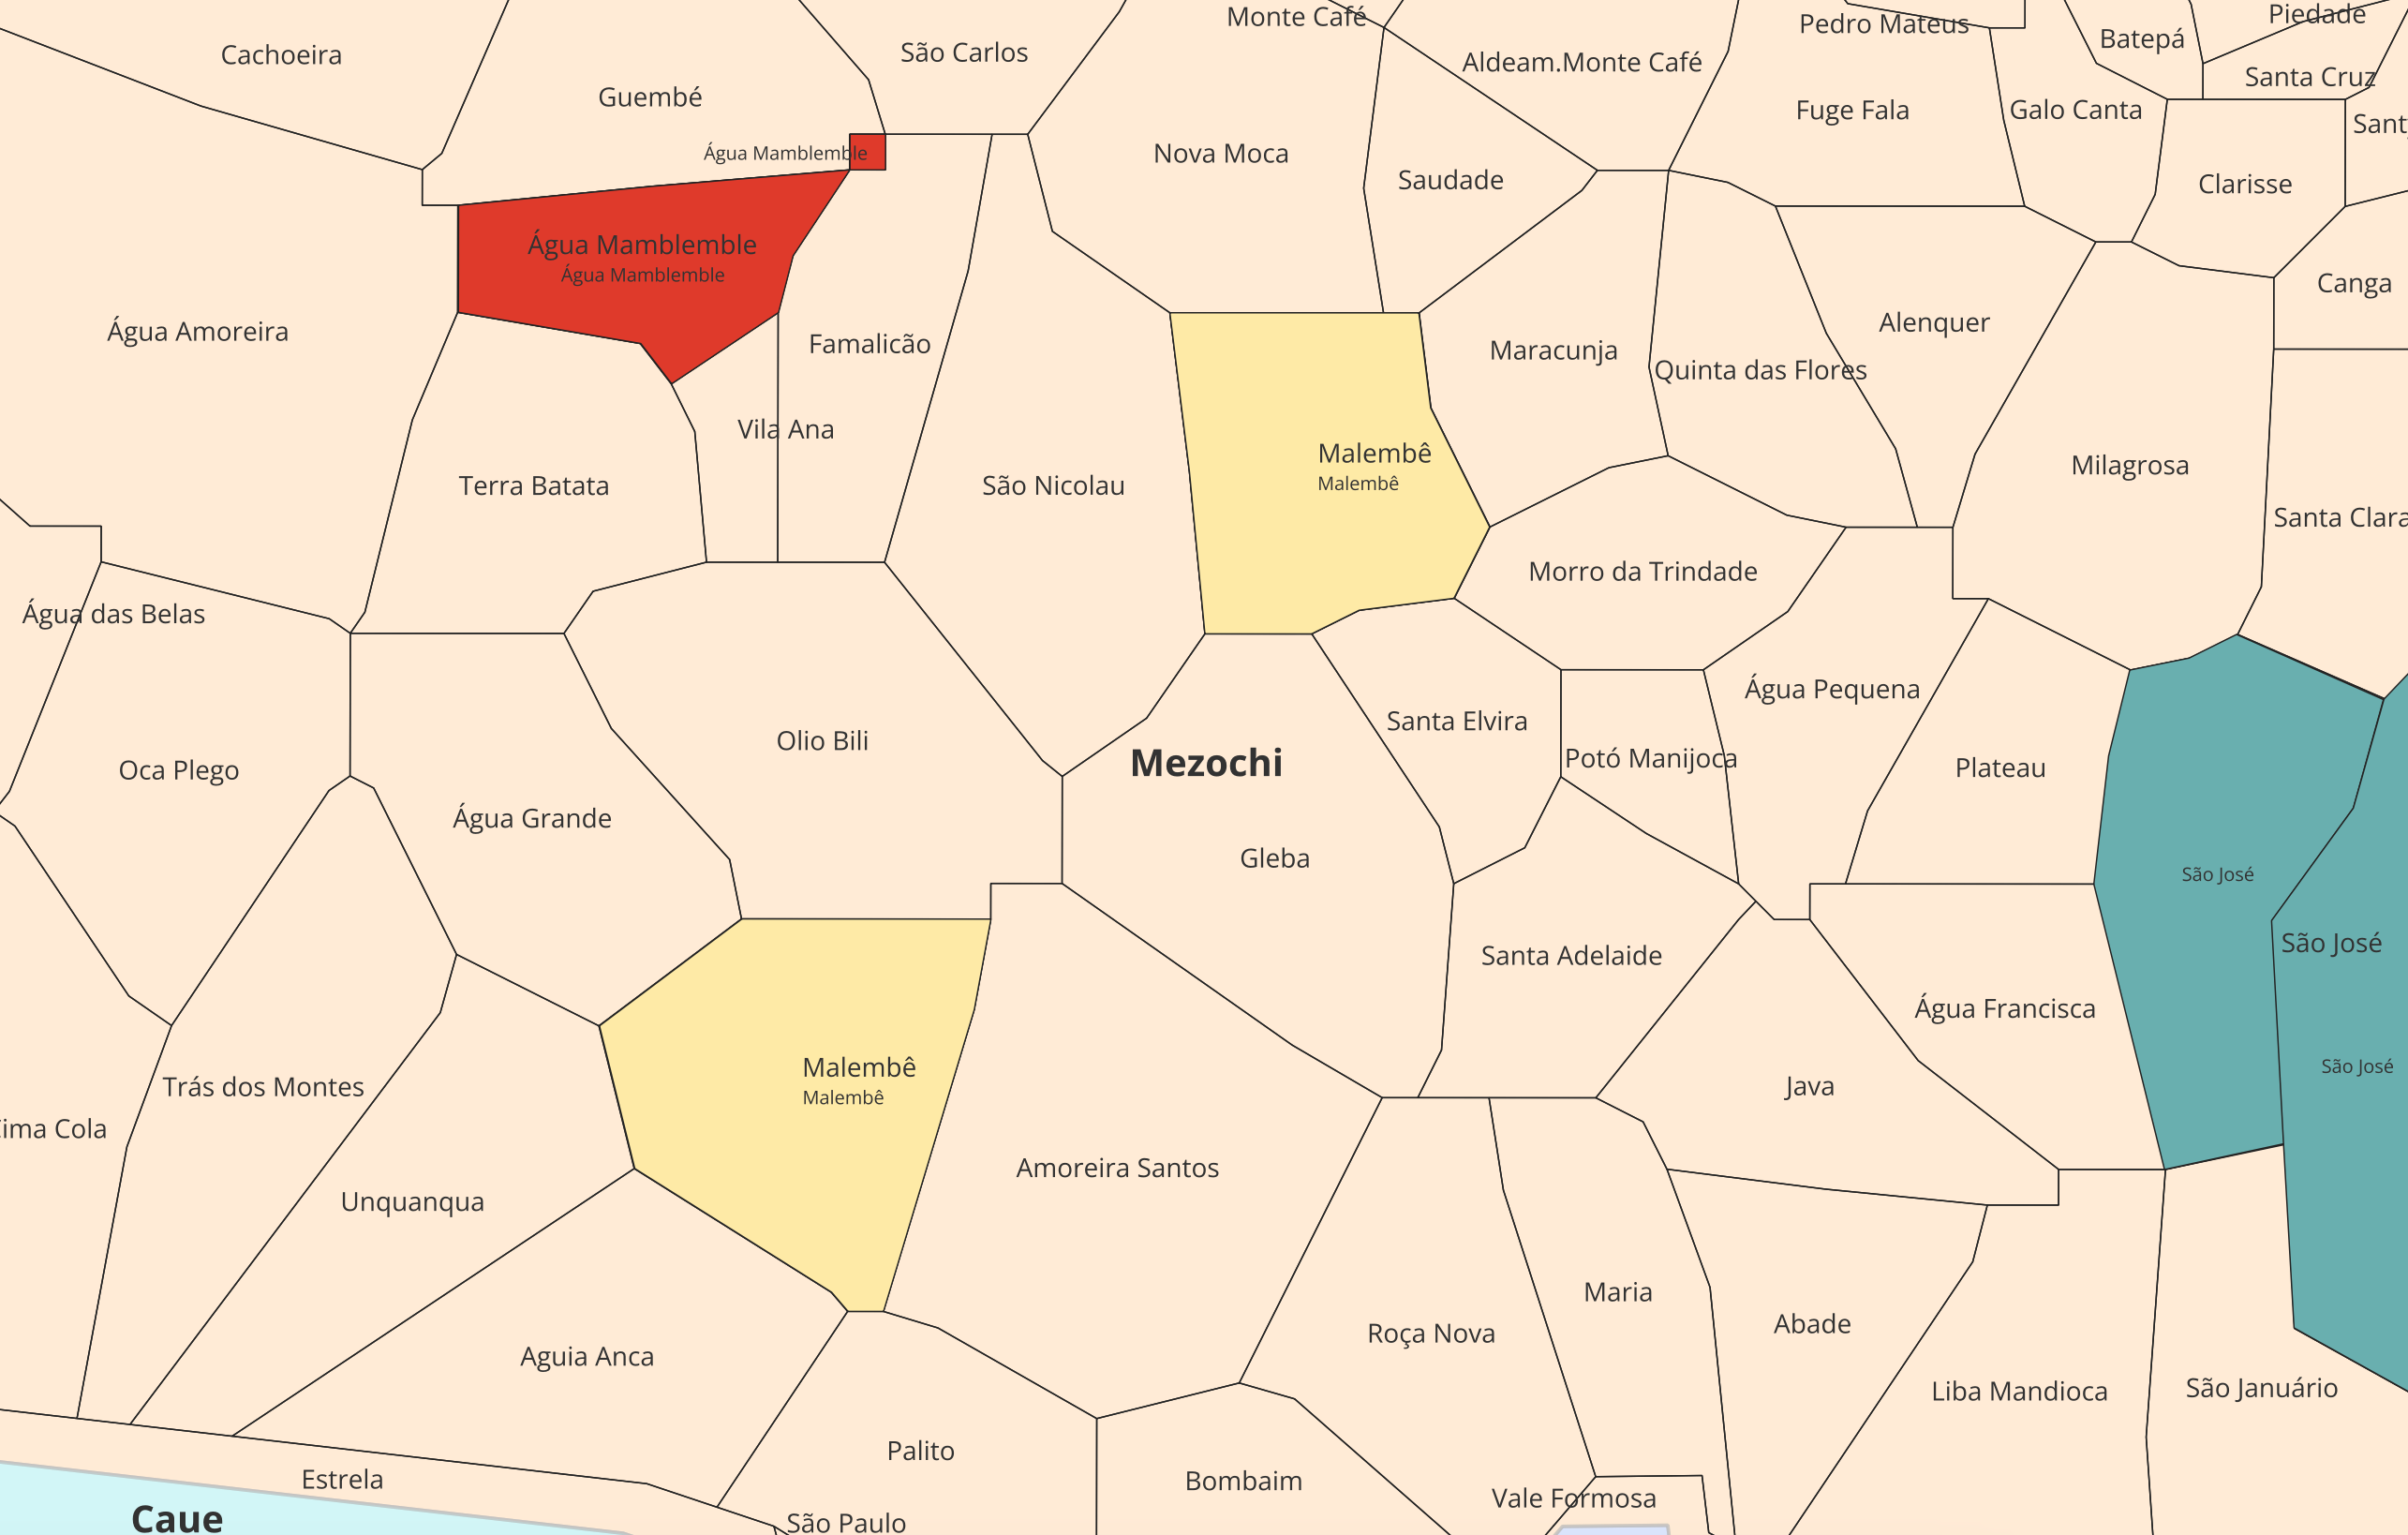
Duplicates to confirm
Two Malembe’s in Mezochi
During the last meeting, STP confirmed the name of North one is wrong
pending of confirmation

Slide 2
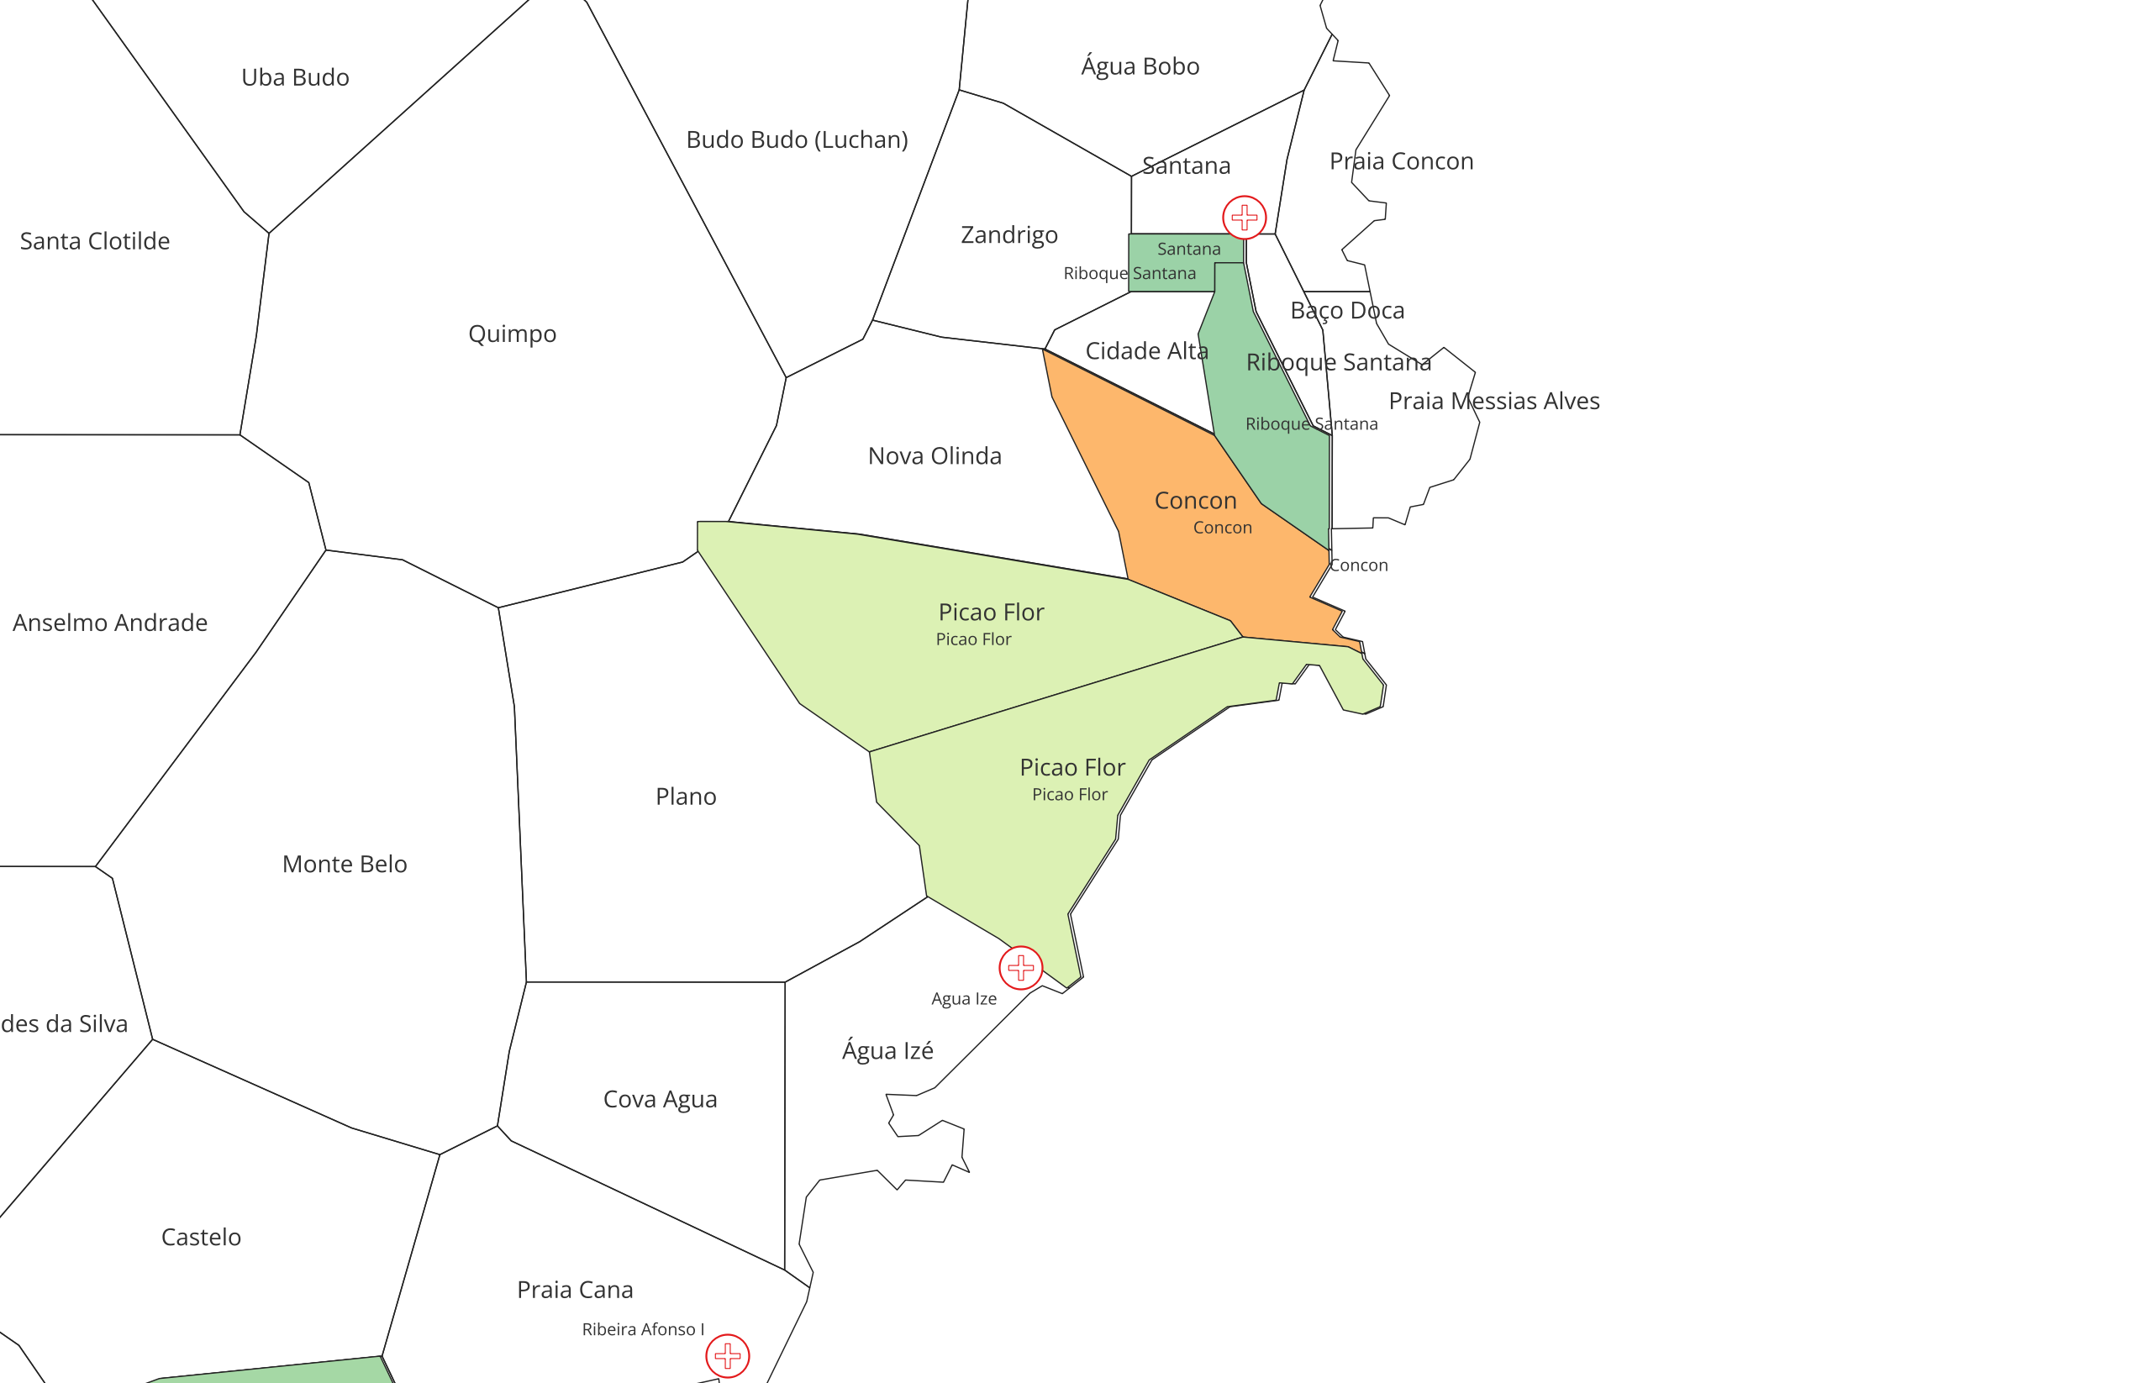
Duplicates to confirm
Two Picao Flor
During the last meeting, STP confirmed the name of South one is wrong, pending of confirmation

Slide 3
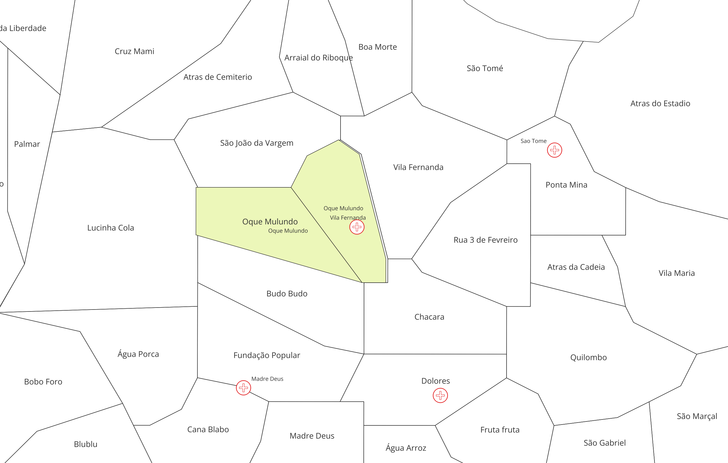
Duplicates to confirm
Two Oque Mulundo’s
During the last meeting, STP confirmed the name of South-west(left) one is wrong
pending of confirmation

Slide 4
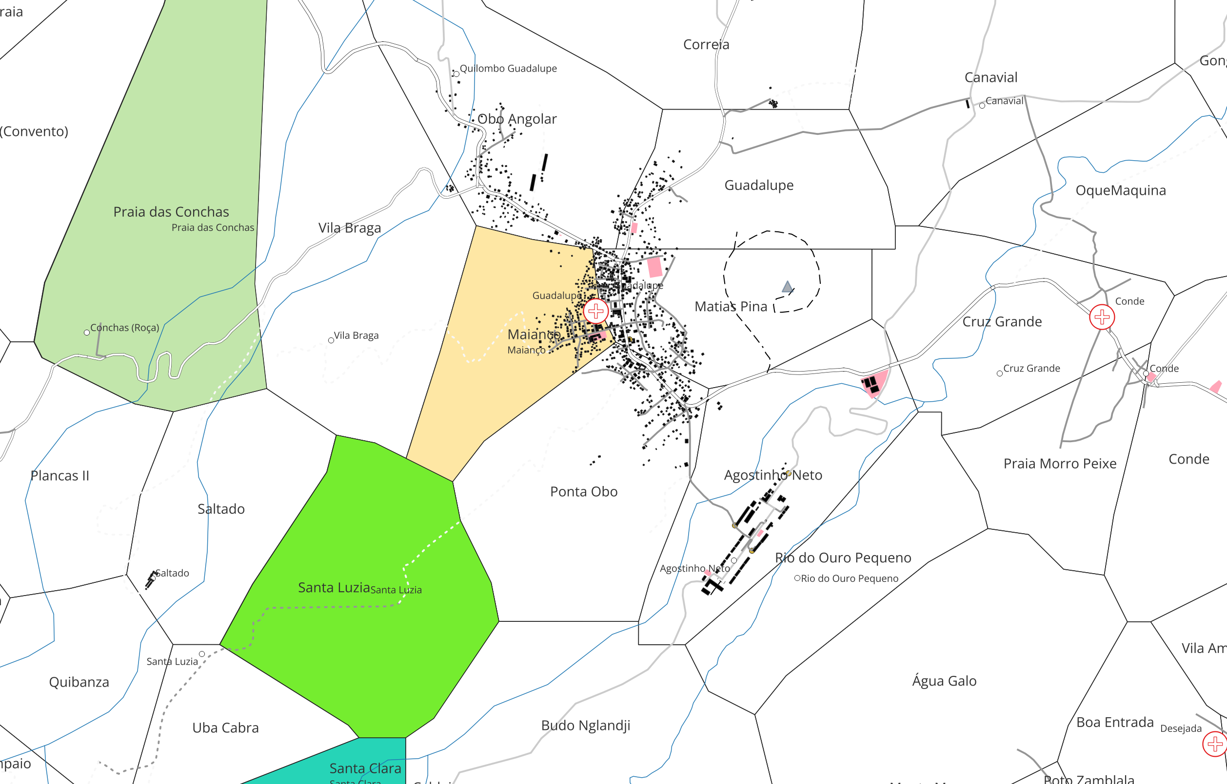
Duplicates to confirm
Two Maianco’s in different districts
During the meeting STP identified the west one, Maianço(West), next to Guadalupe is incorrect
pending for the correct name

Slide 5
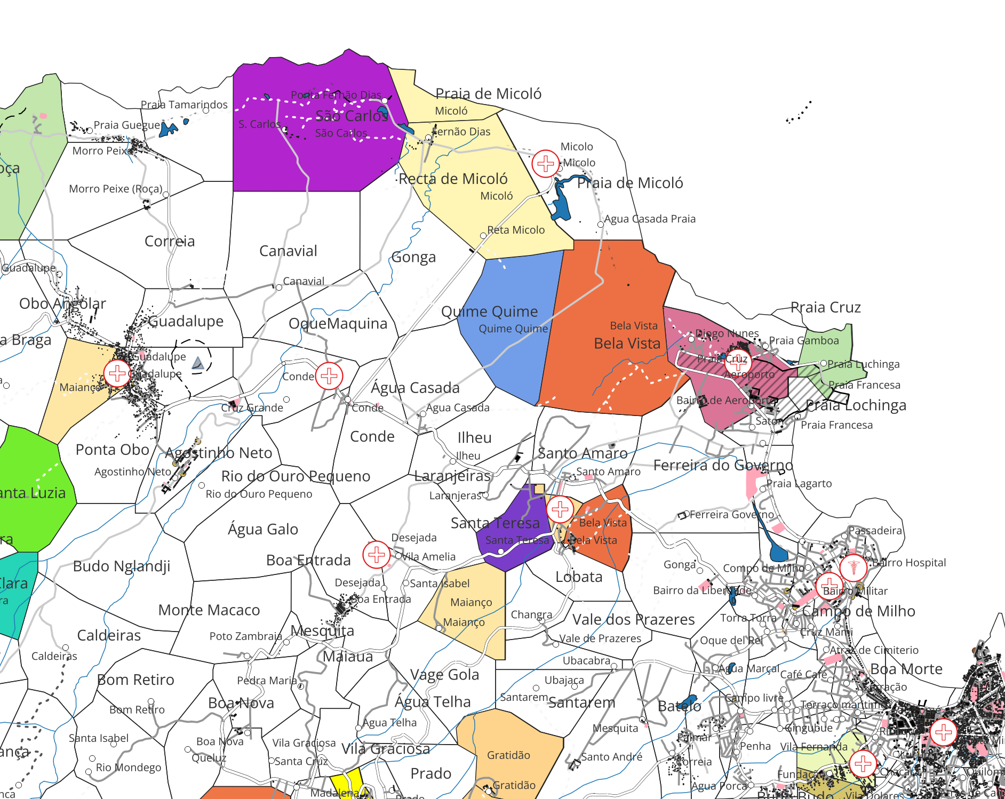
Duplicates to confirm
During the meeting STP confirmed Quime Quime should not be in Lobata
Pending for the correct name

Slide 6
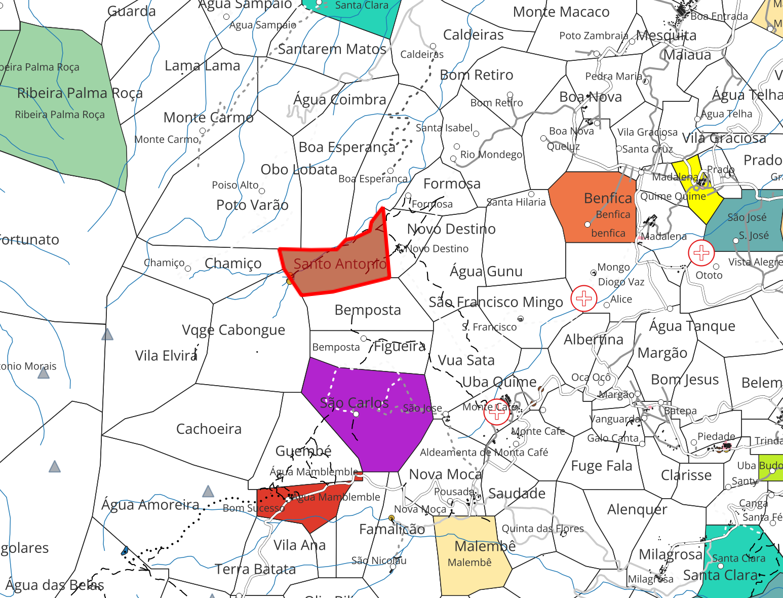
Duplicates to confirm
During the meeting STP confirmed Santo Antonio should not be in Mezochi
Pending for the correct name

Slide 7
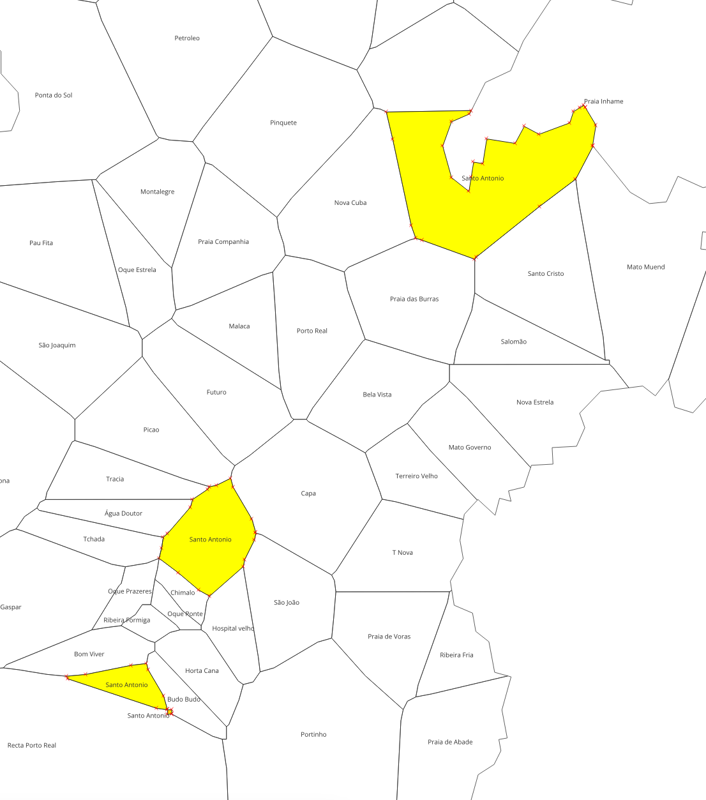
Three Santo Antonio’s in Principe
requires confirmation:
should they be merged? Or renamed?

Slide 8
The following slides are the maps from the latest shapefile, ONLY FOR REFERENCE

Slide 9
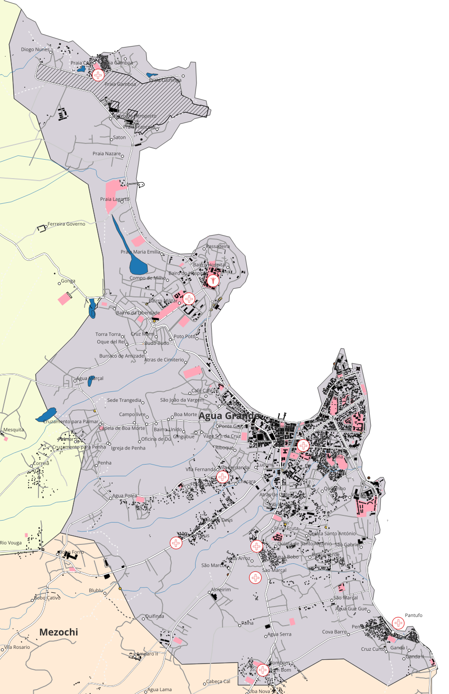
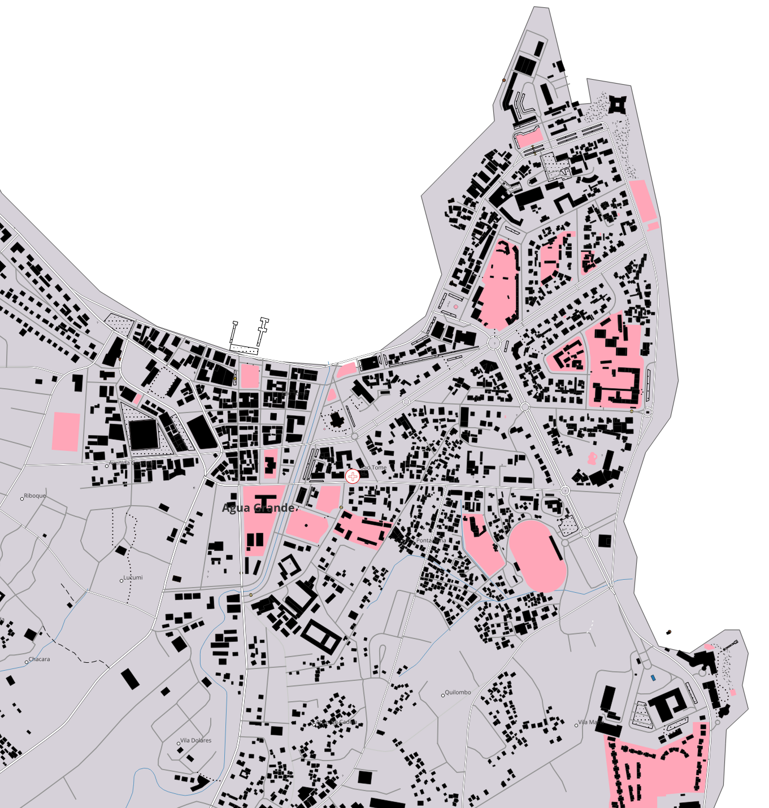
Agua Grande

Slide 10
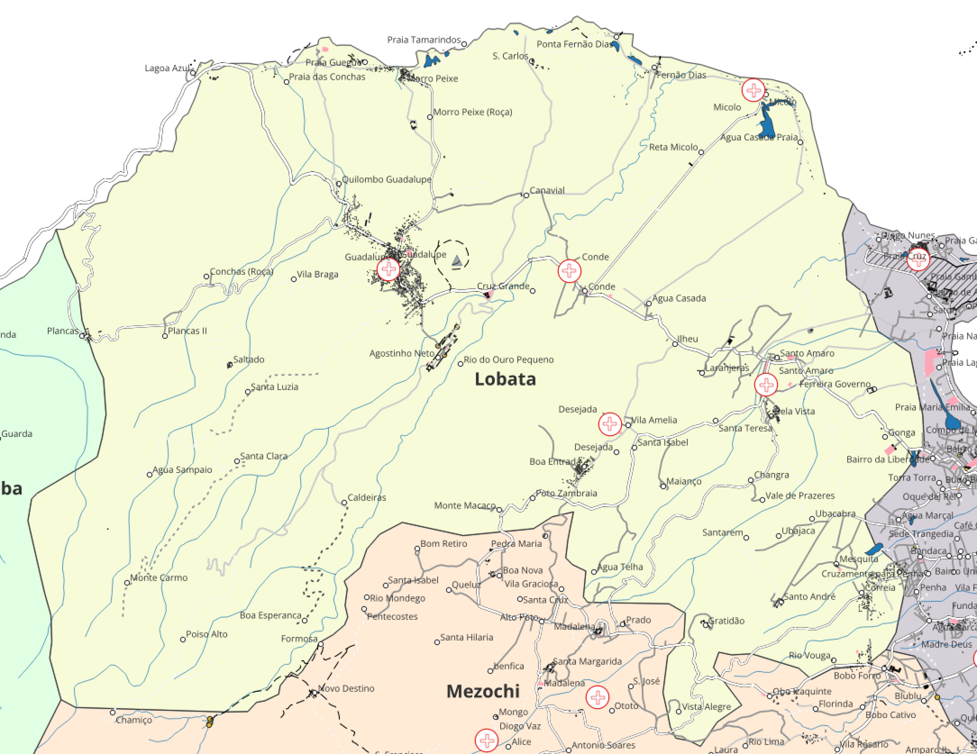
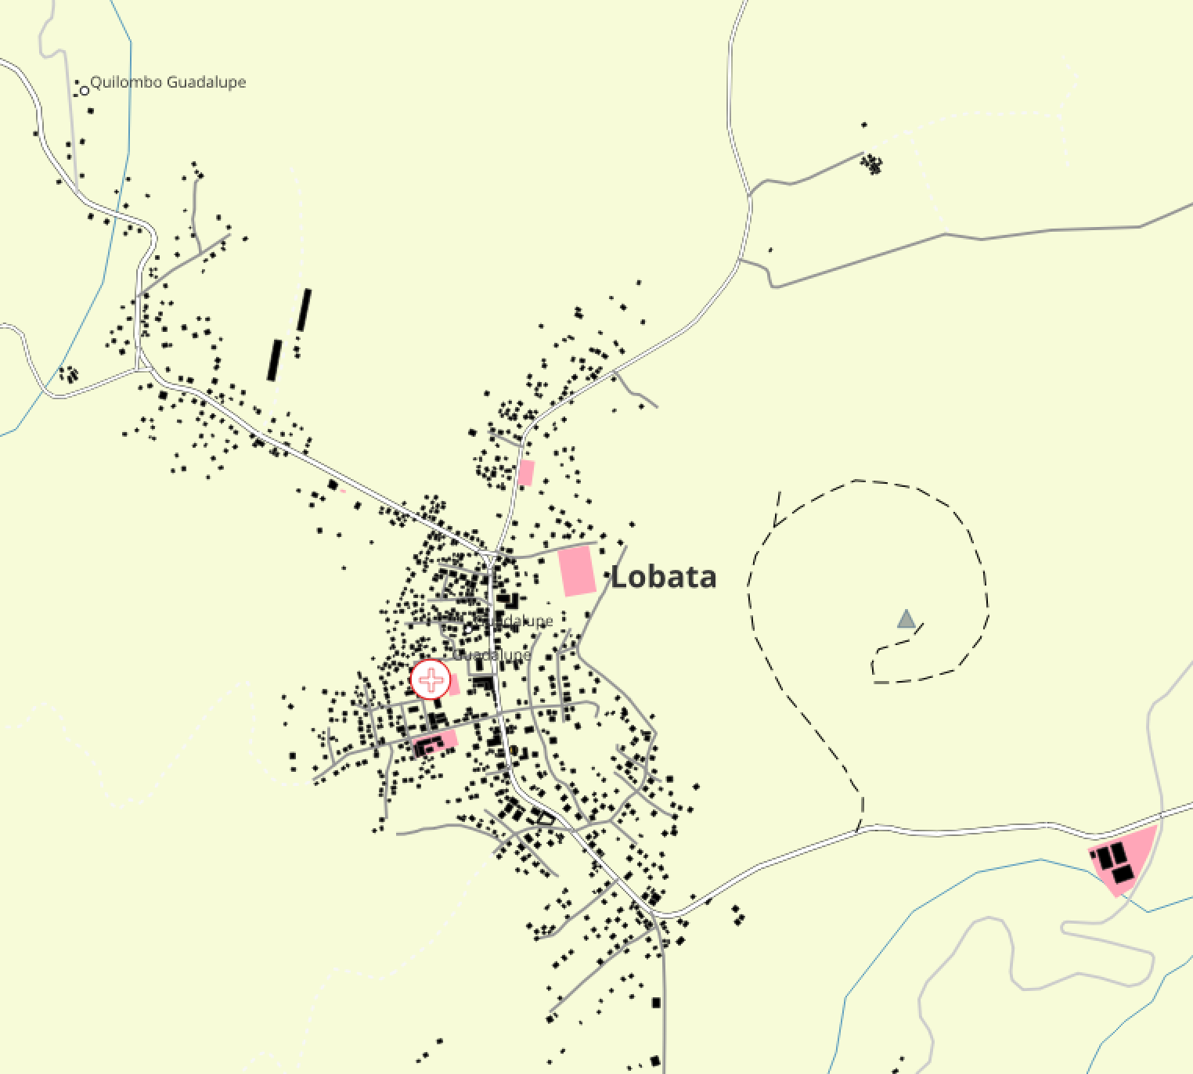
Lobata

Slide 11
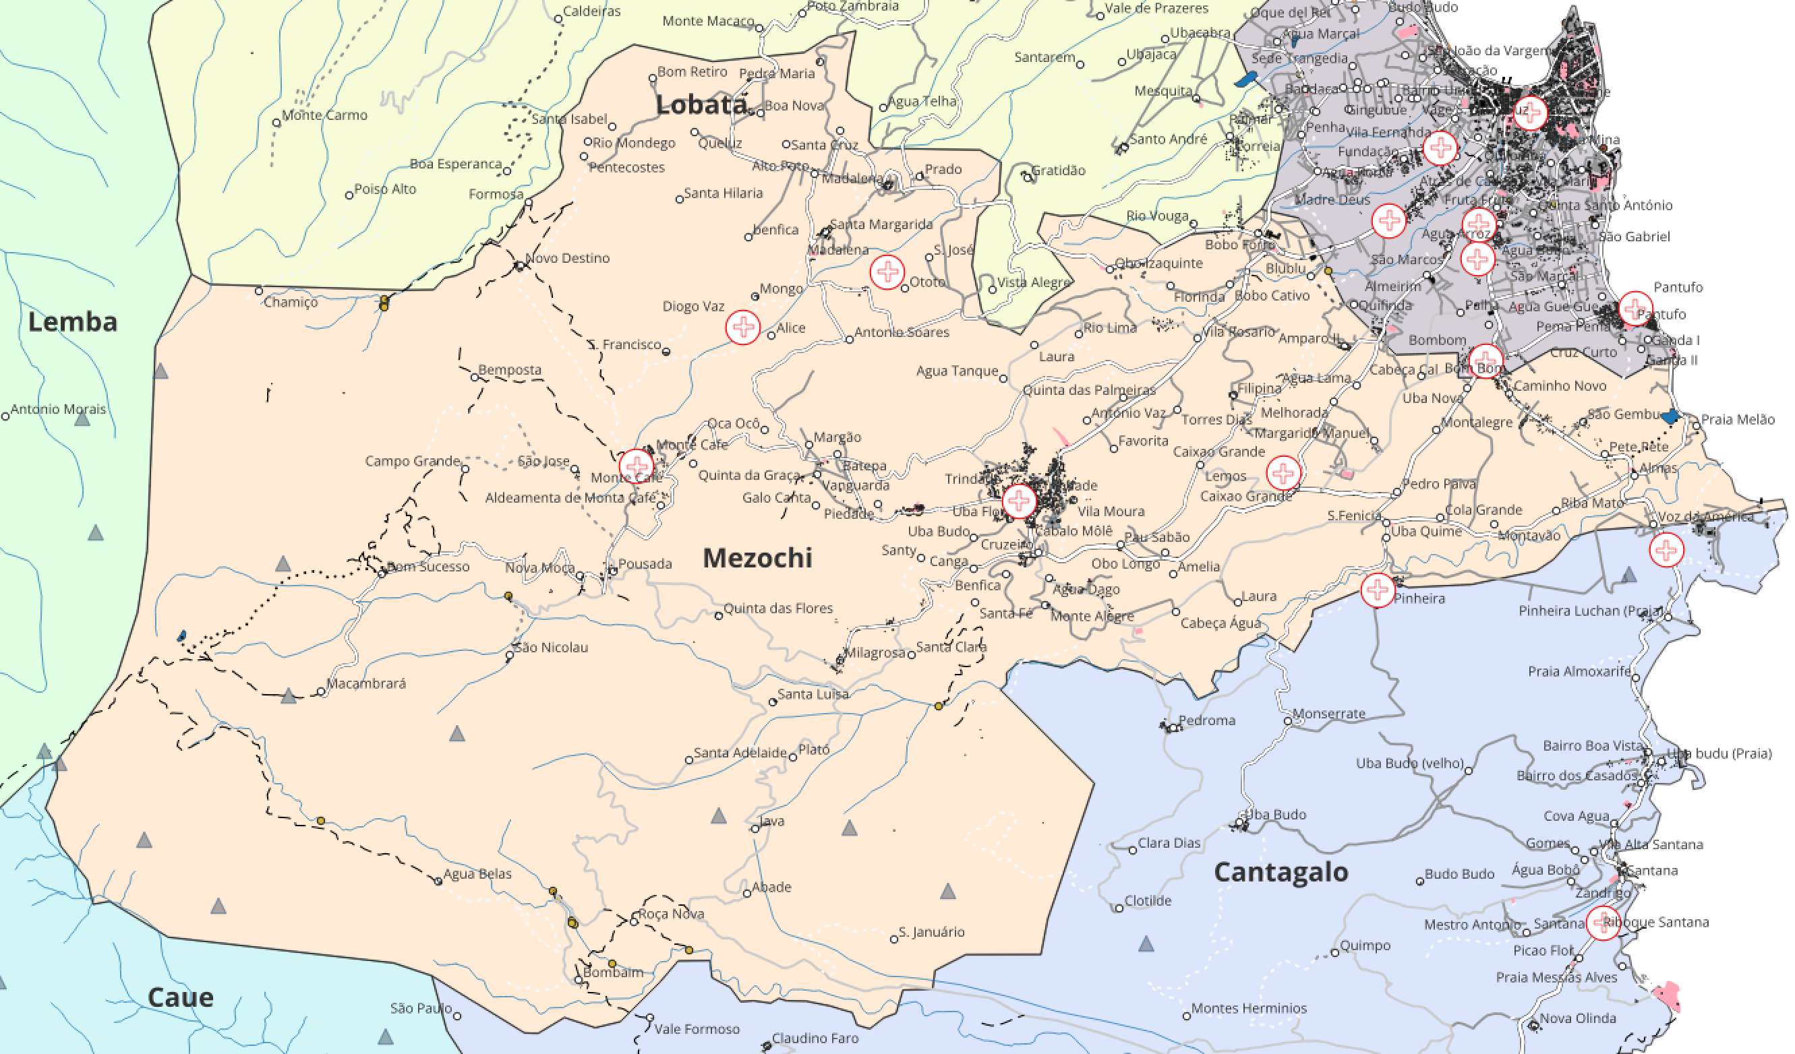
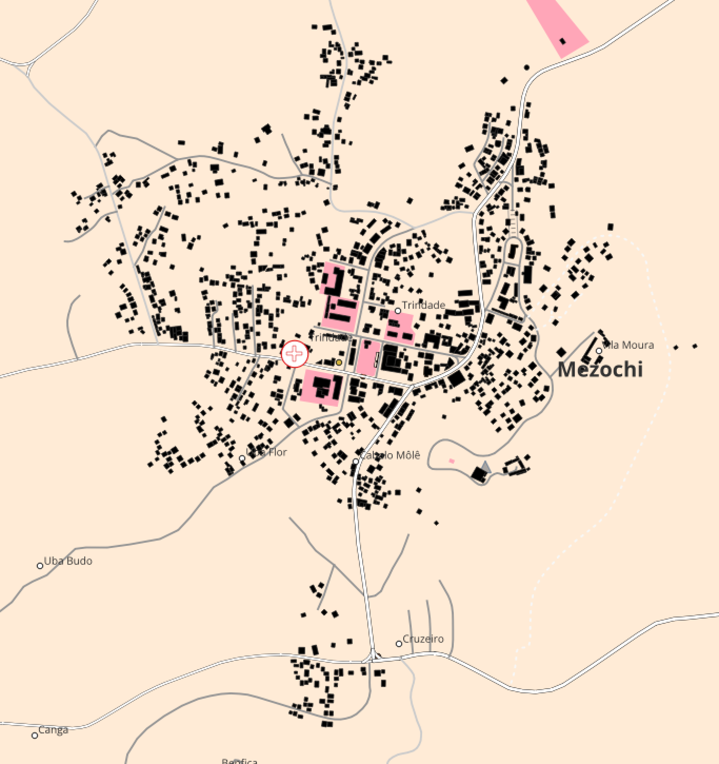
Mezochi

Slide 12
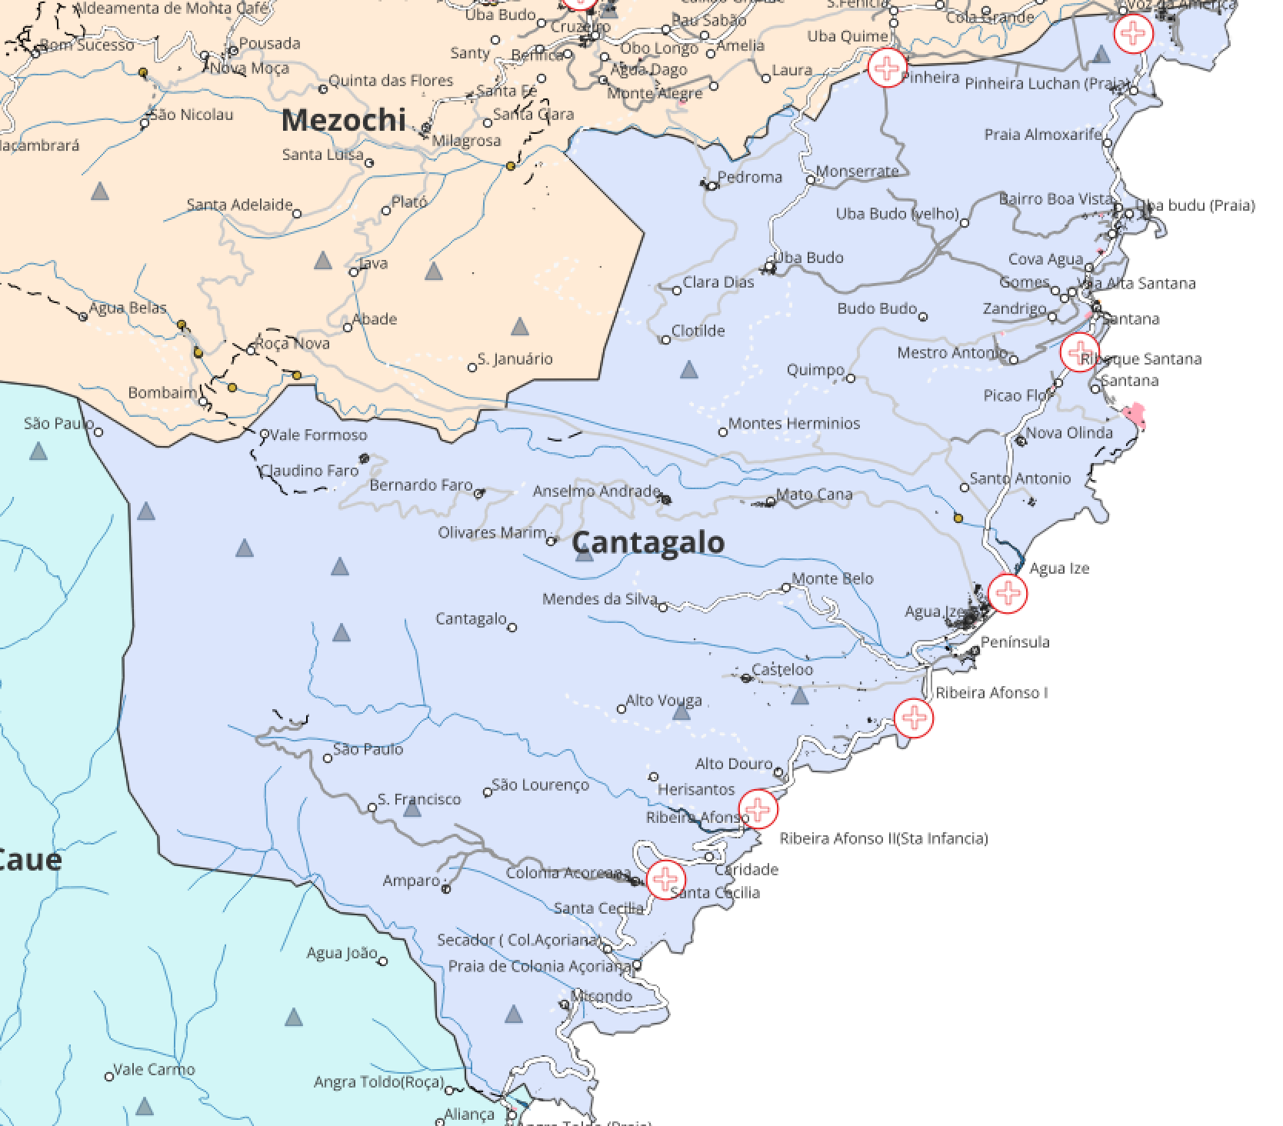
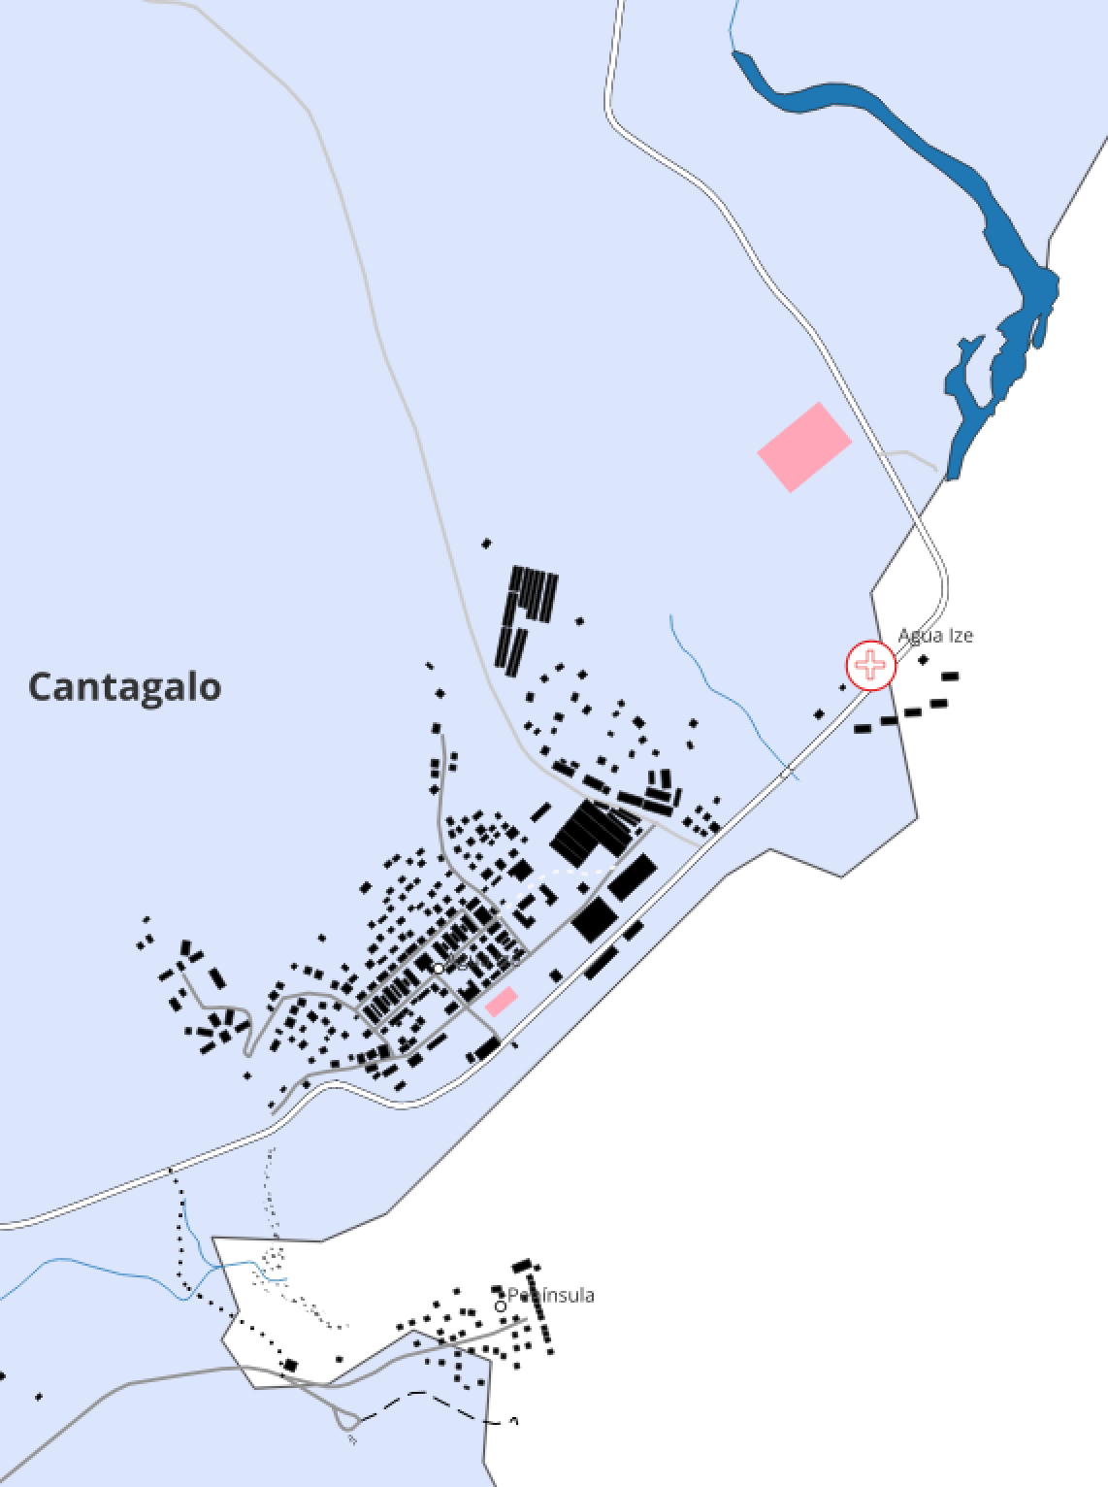

Slide 13
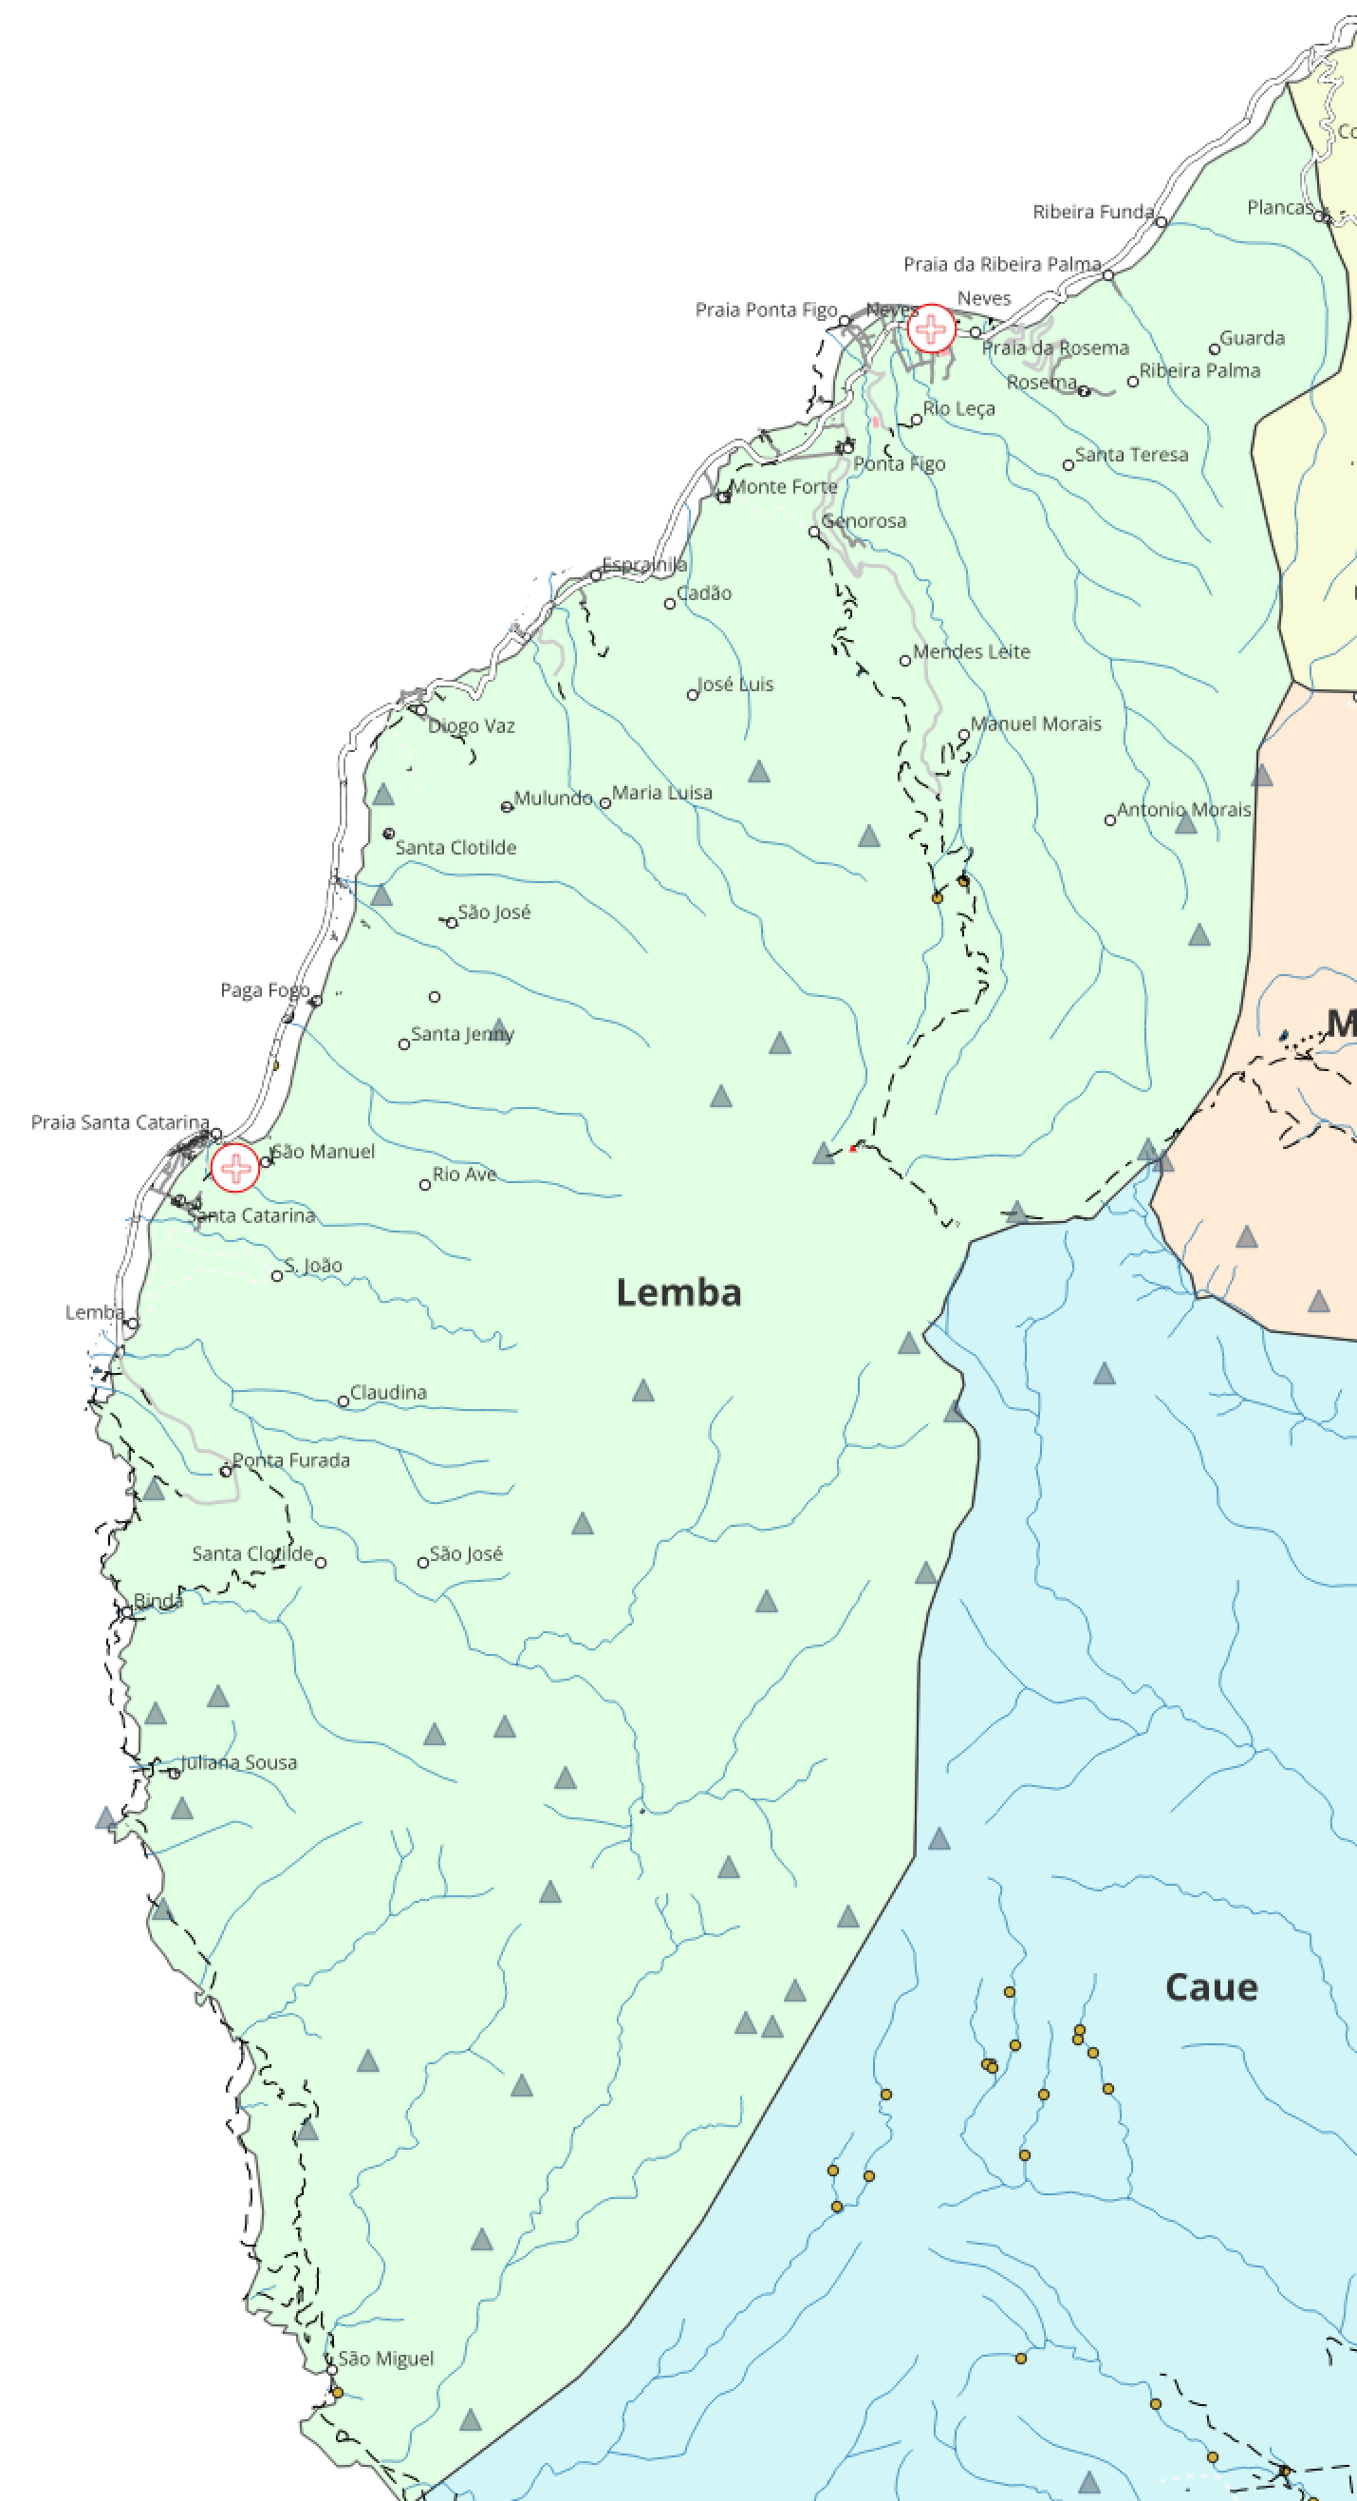
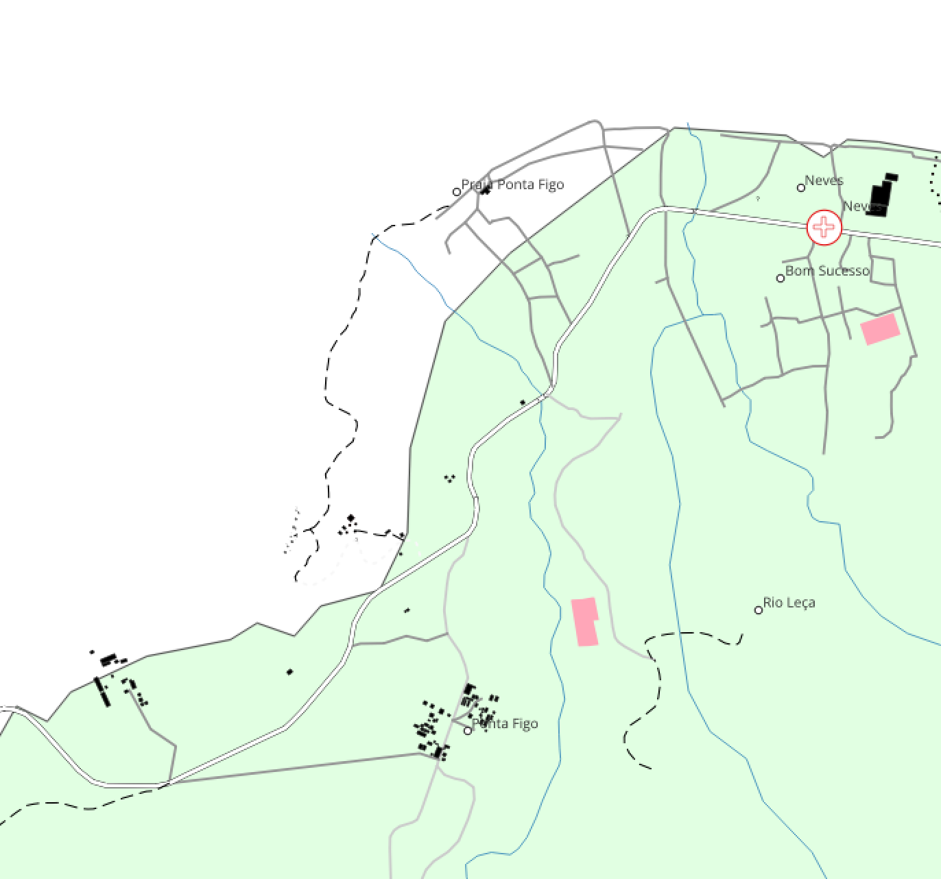
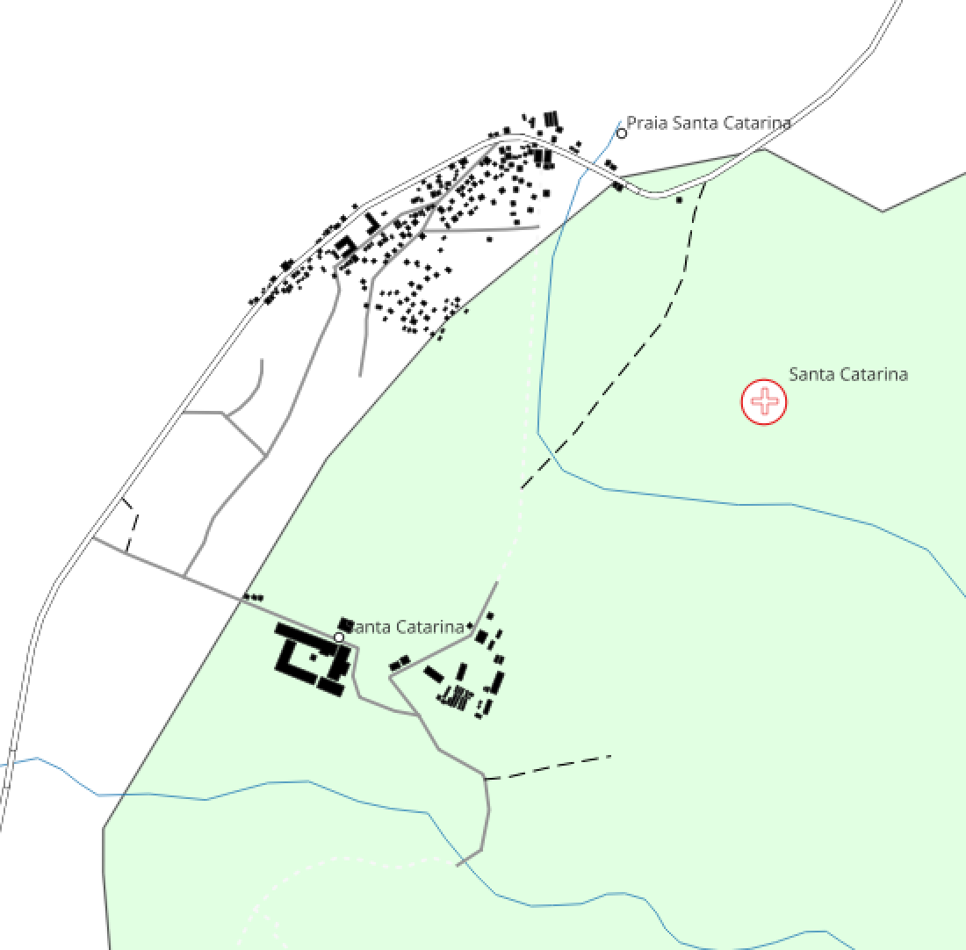
Lemba

Slide 14
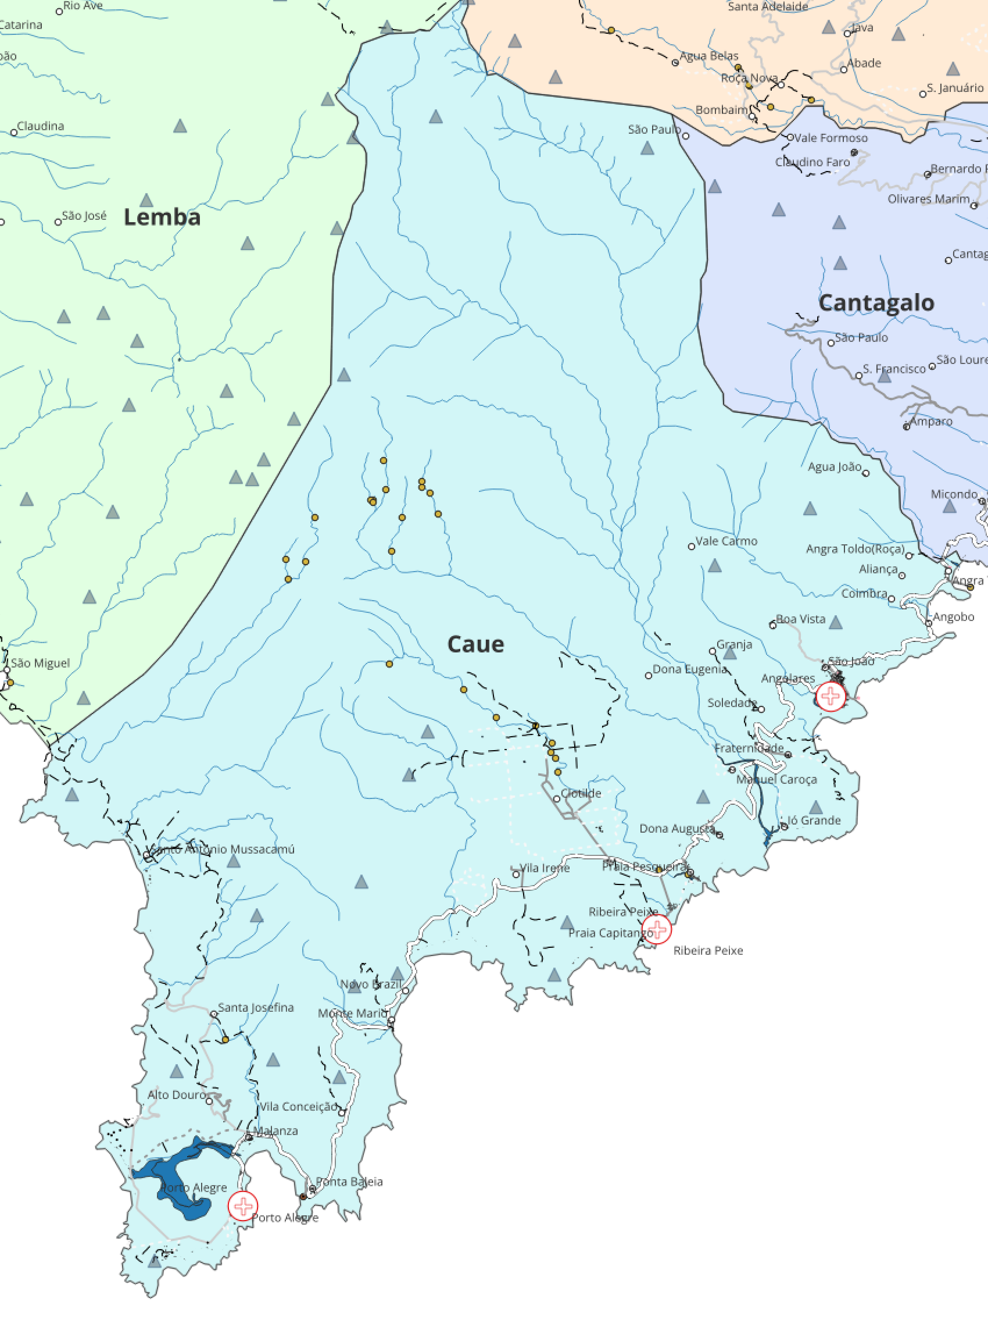
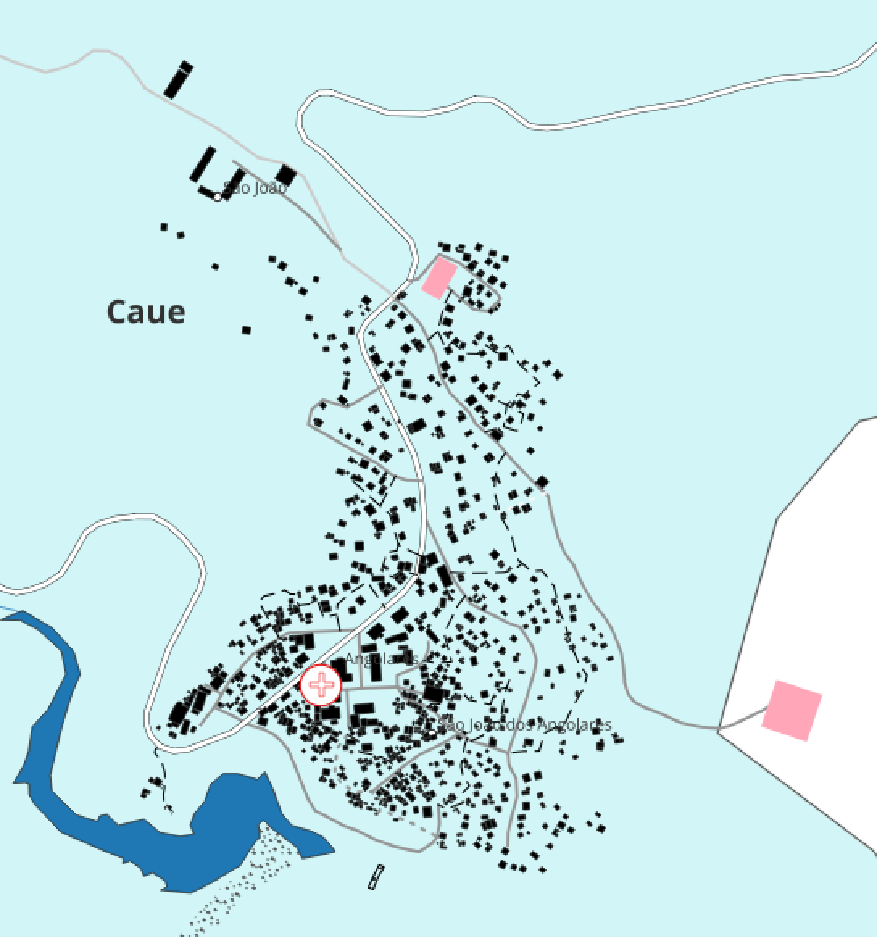
Caue

Slide 15
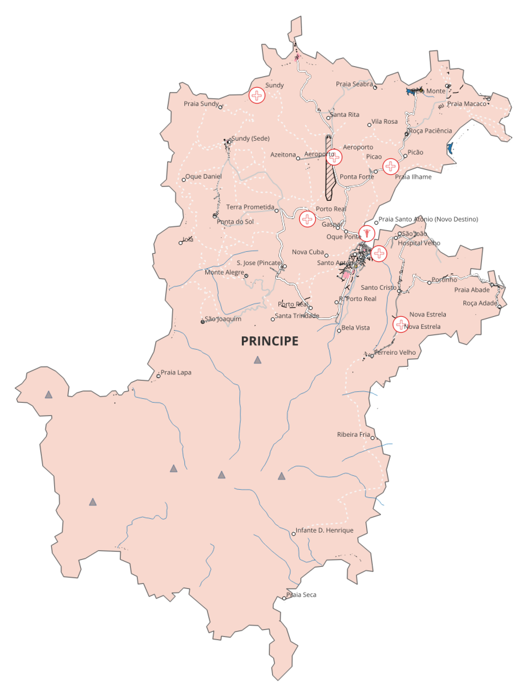
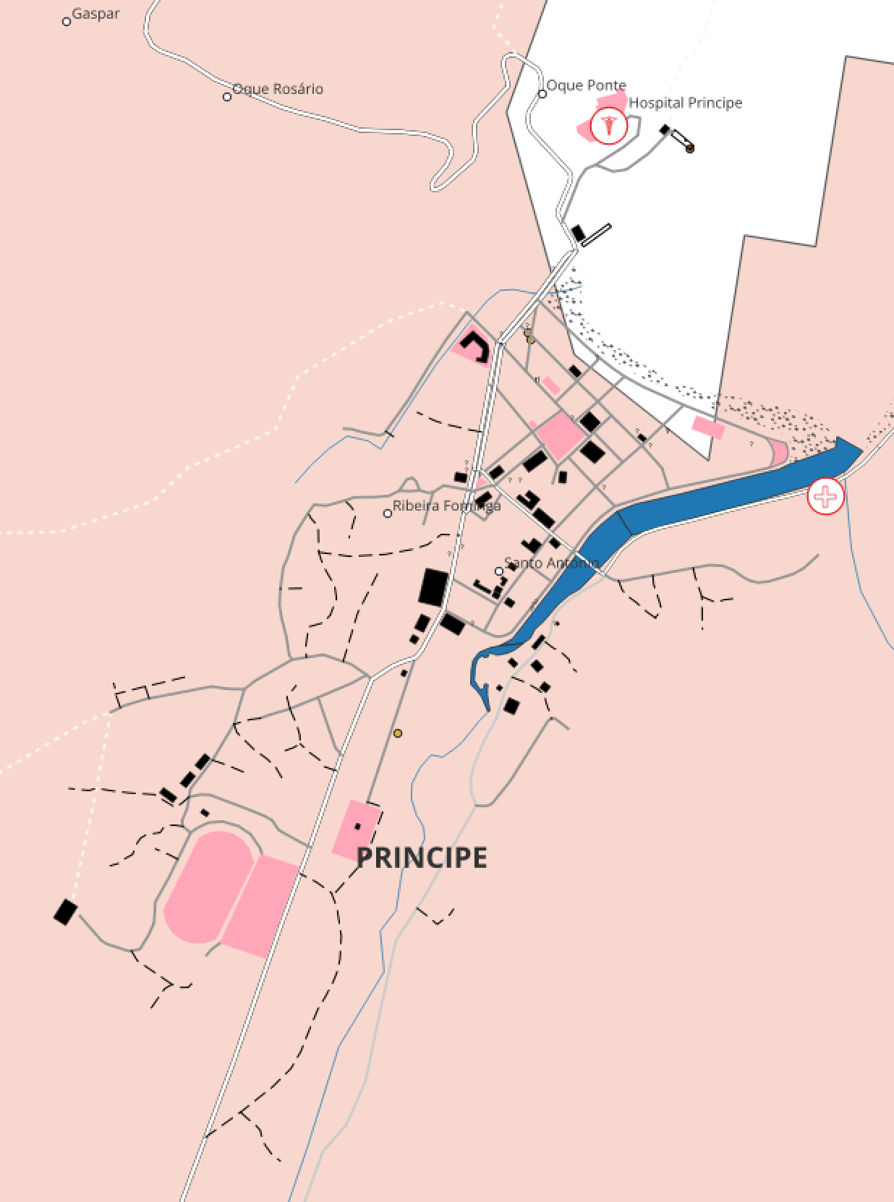
Principe

Slide 16
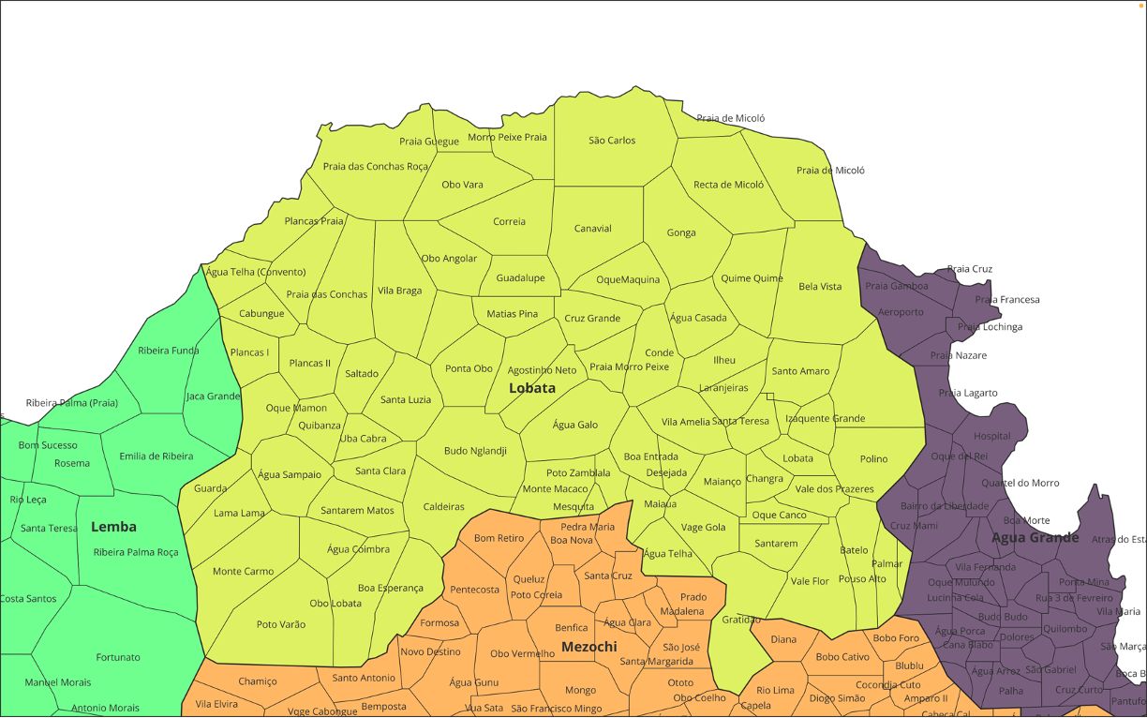

Slide 17
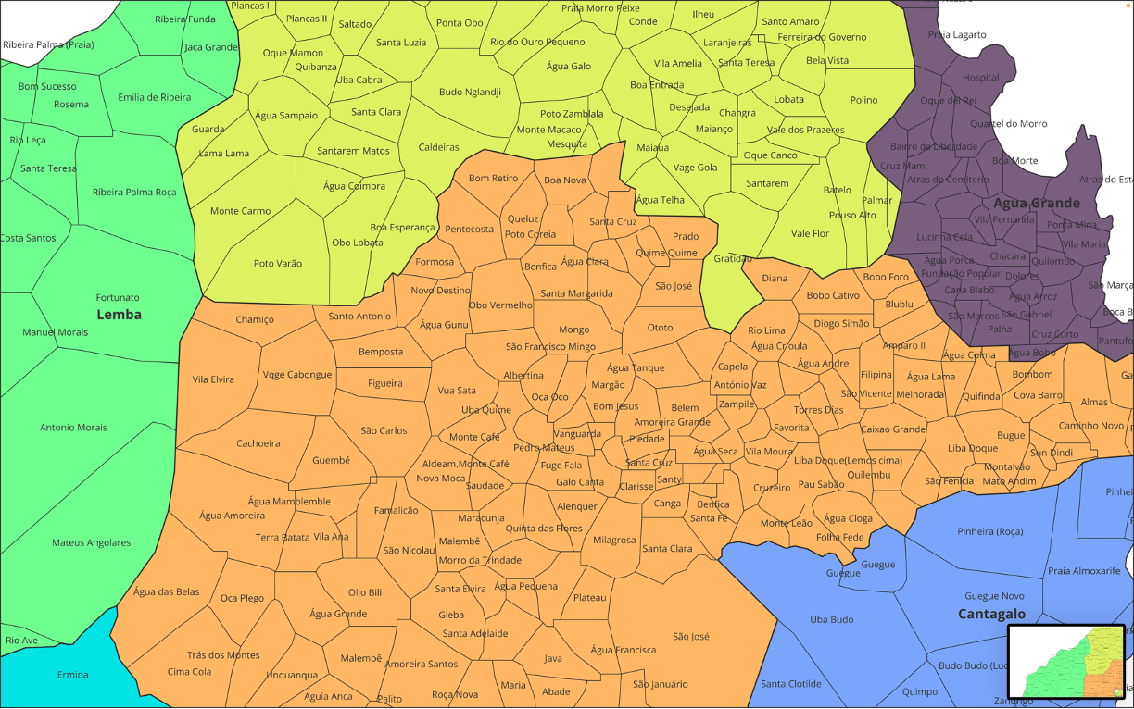

Slide 18
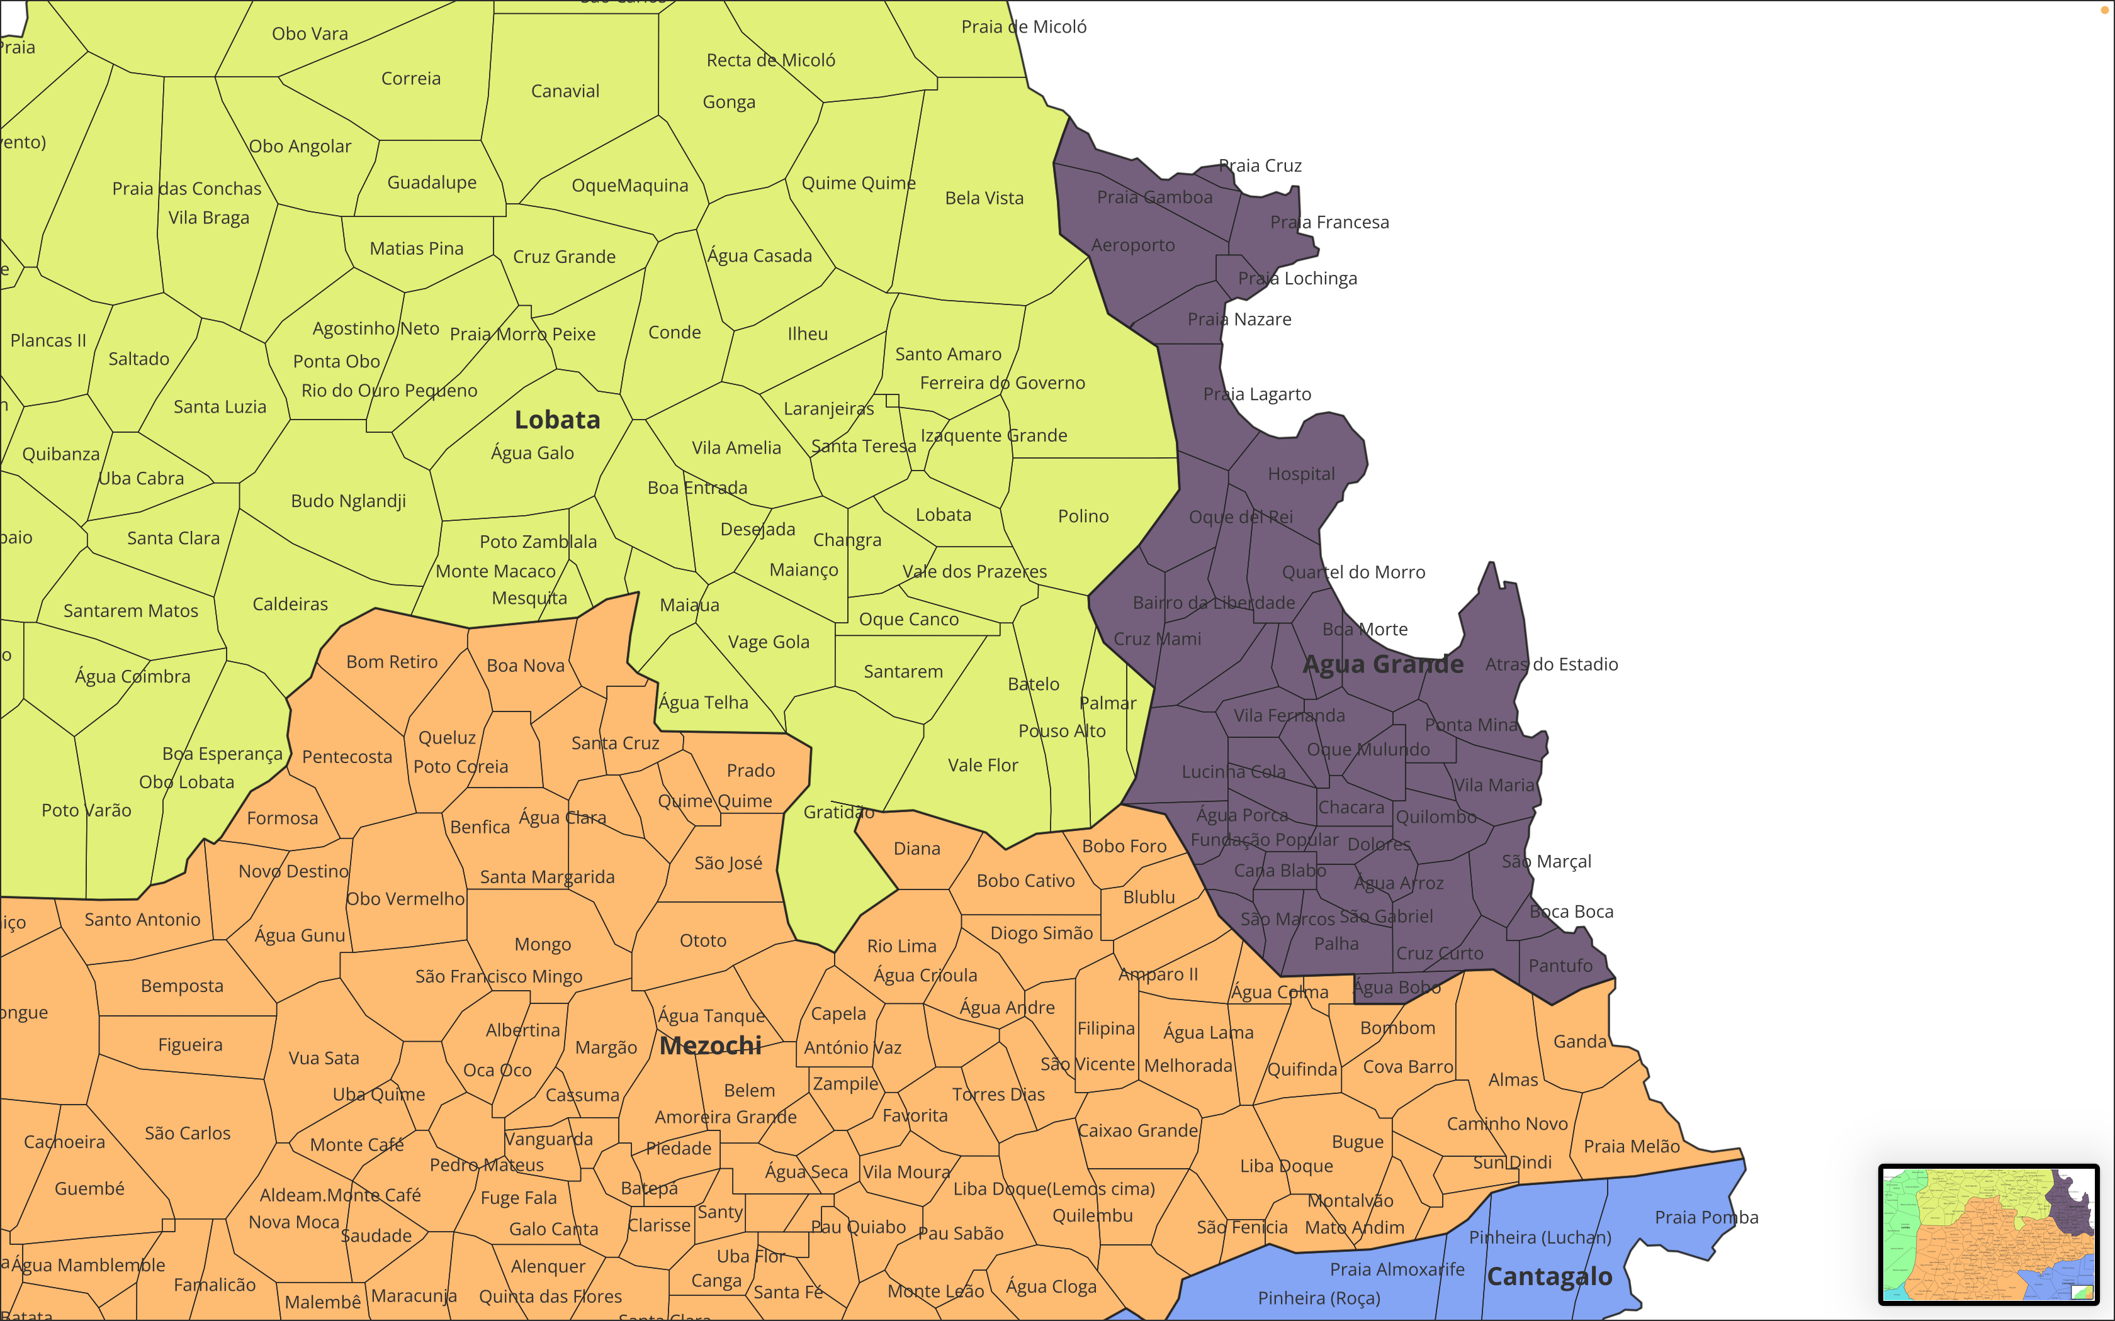

Slide 19
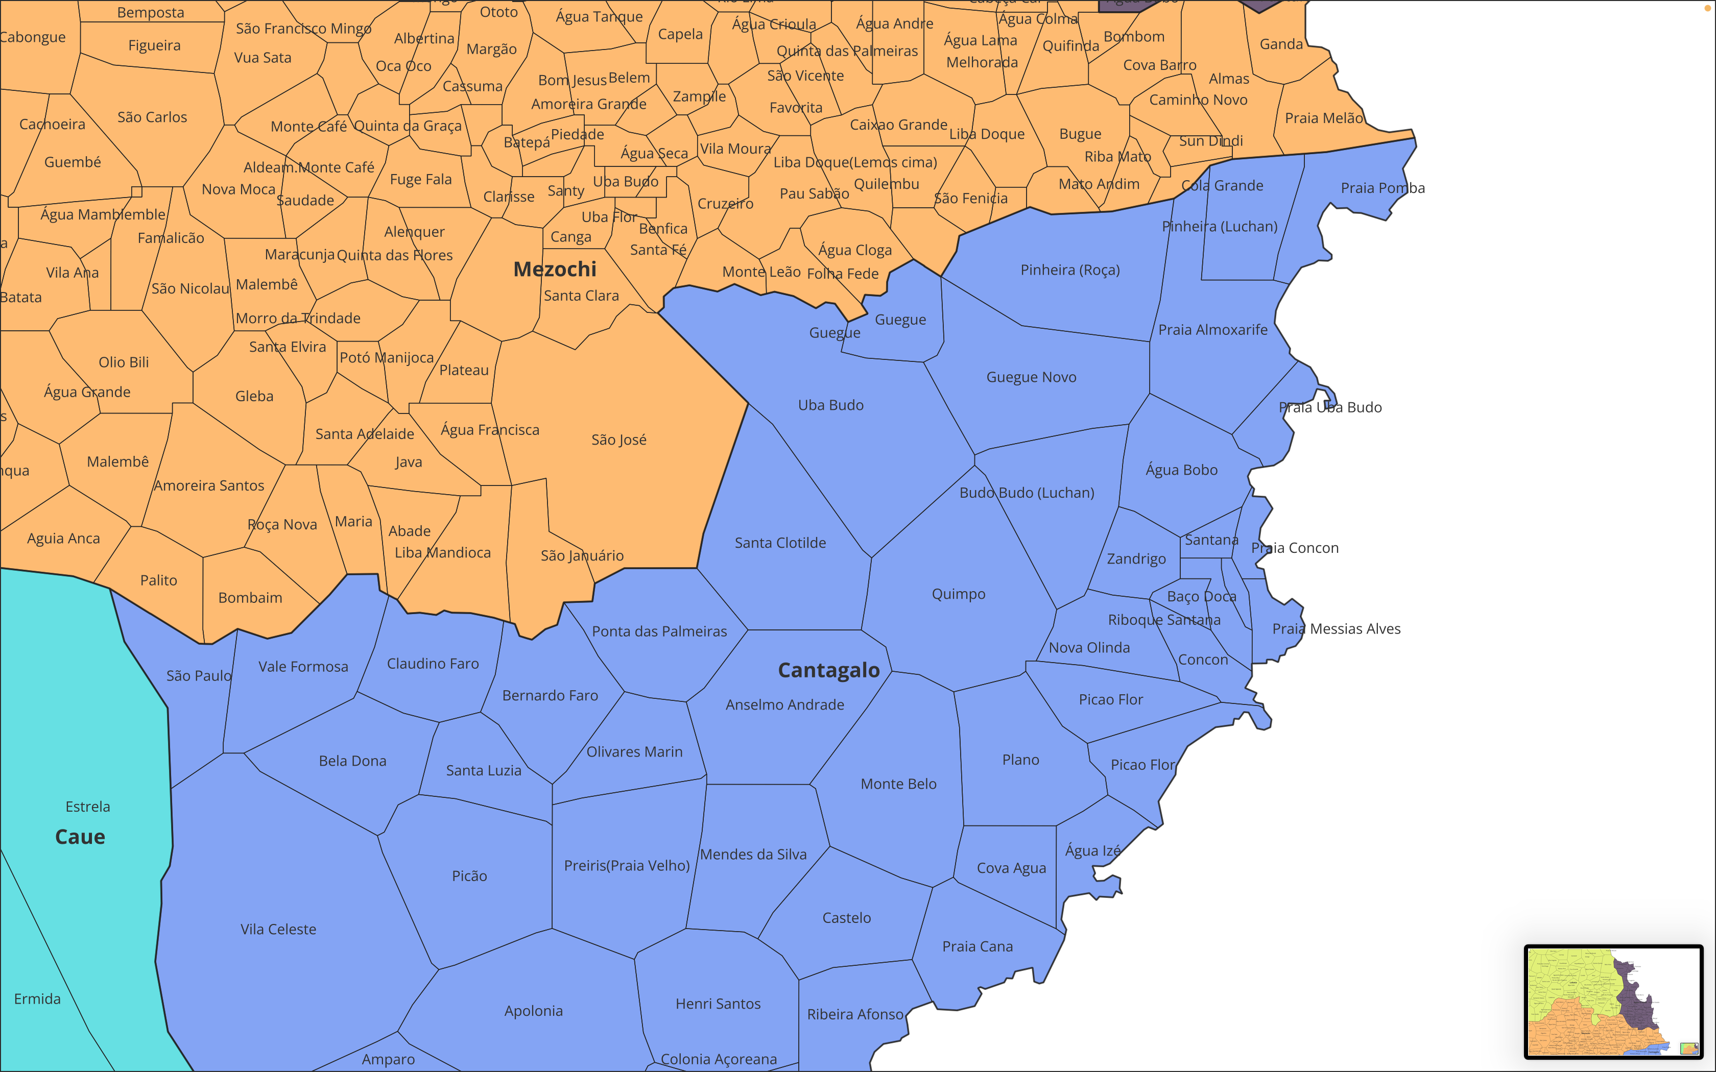

Slide 20
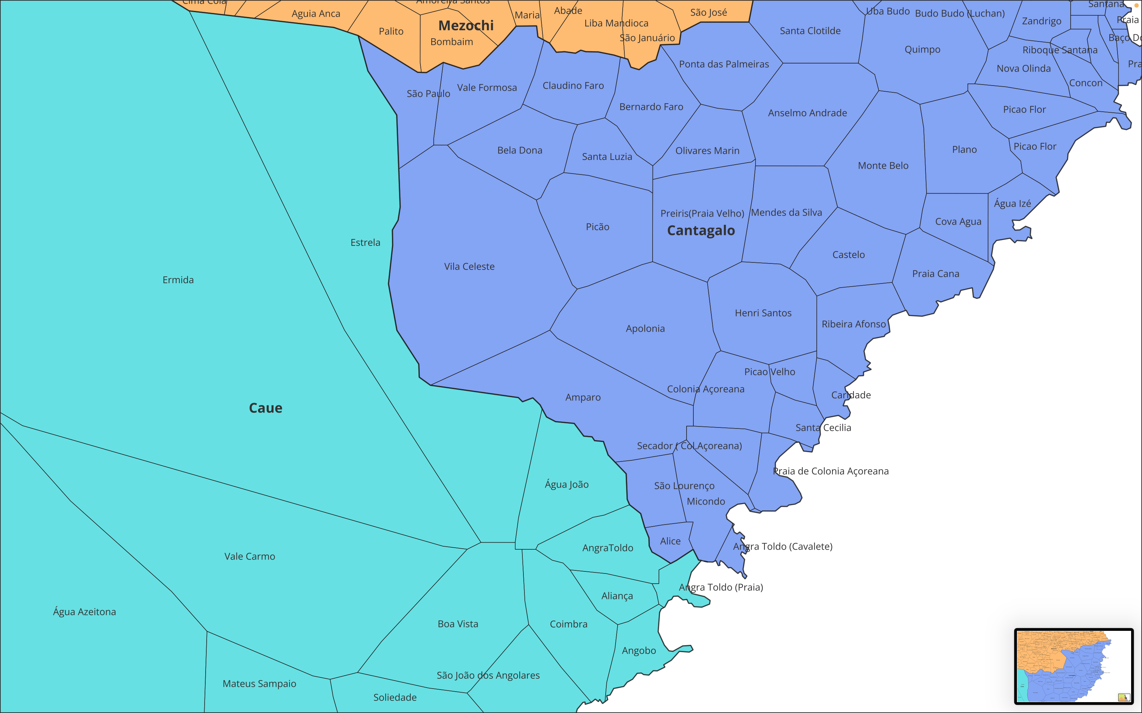

Slide 21
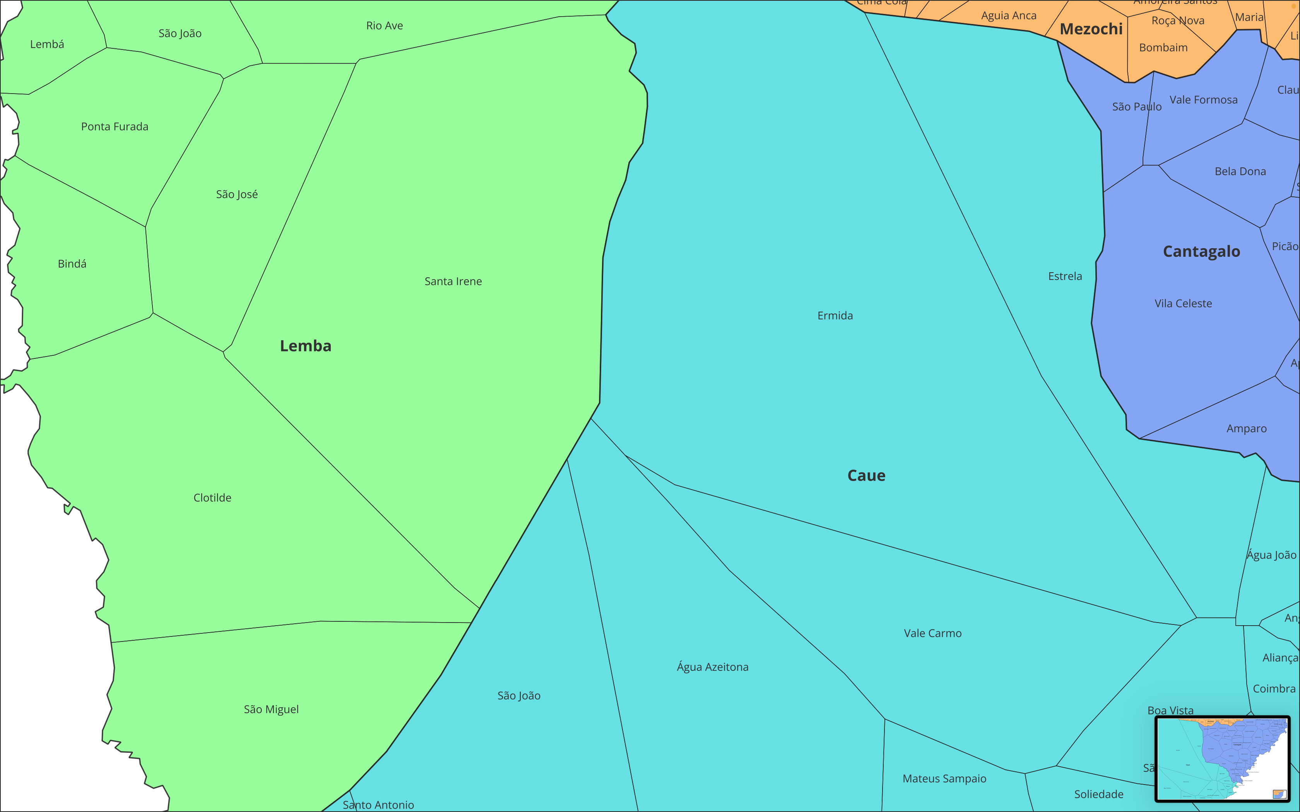

Slide 22
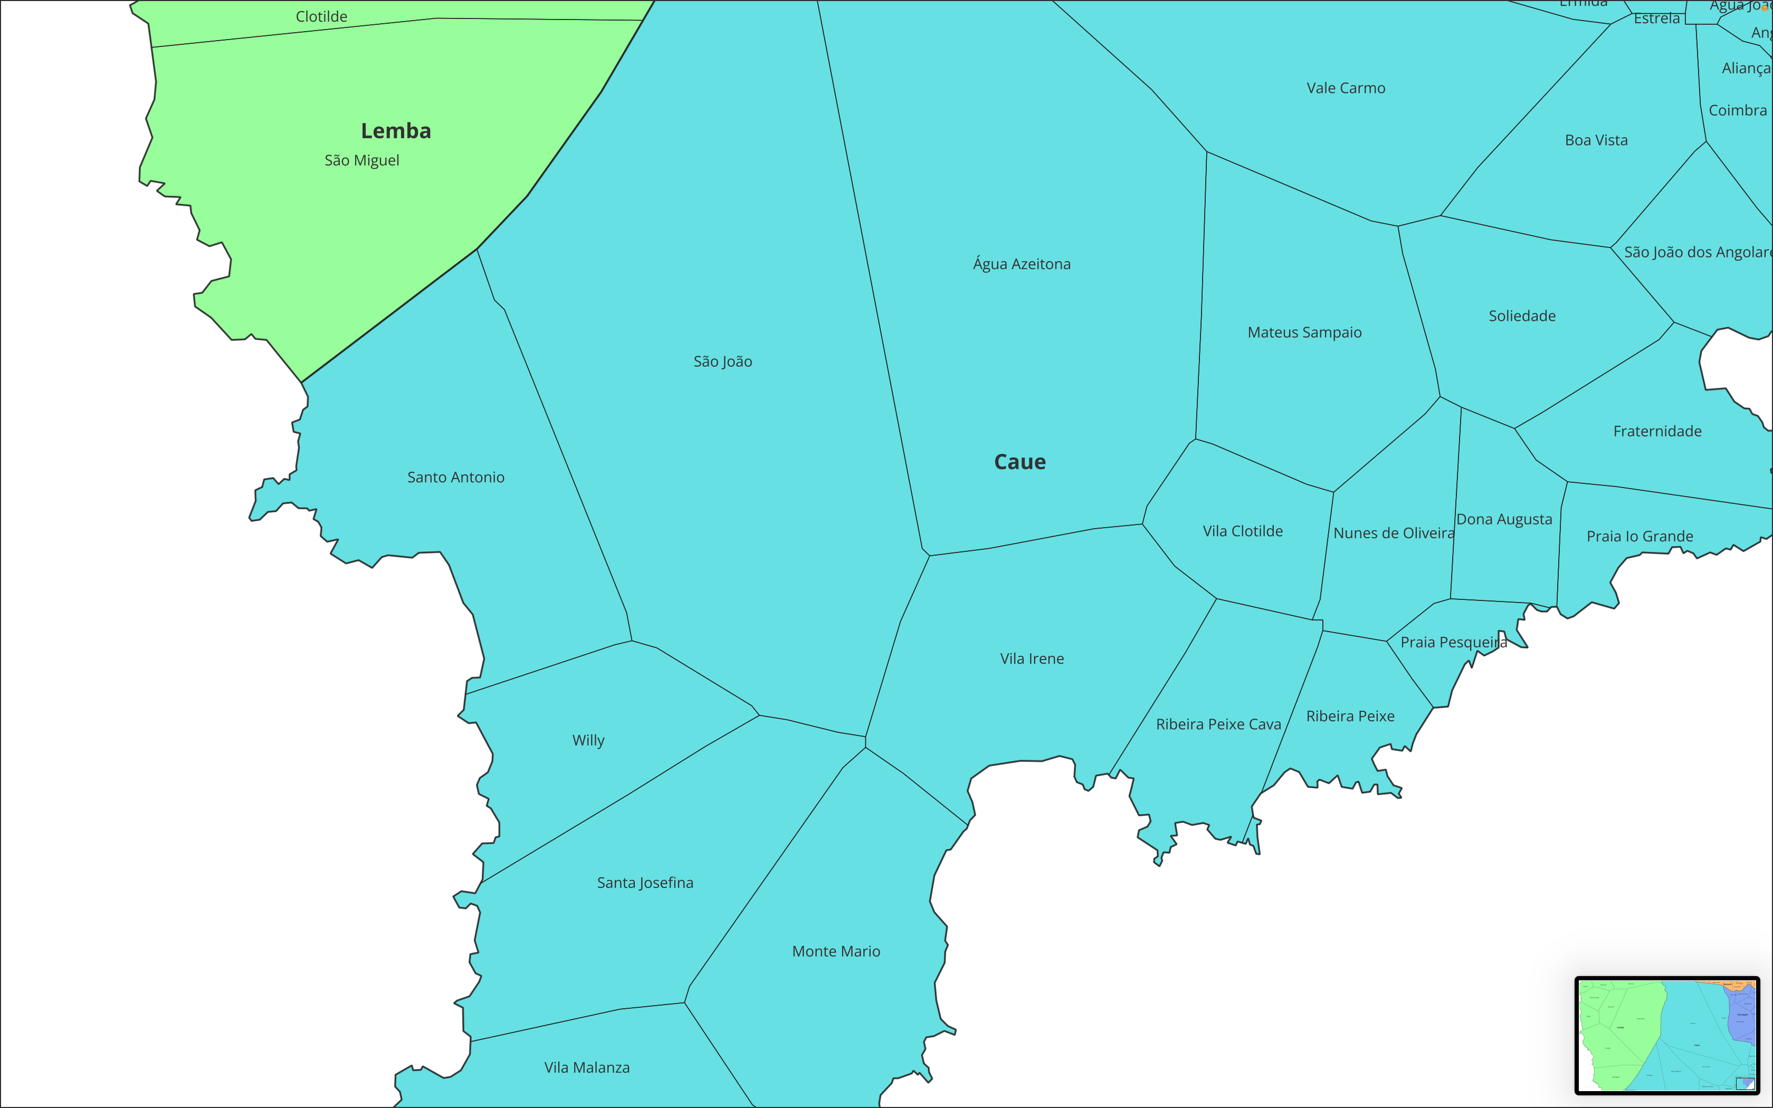

Slide 23
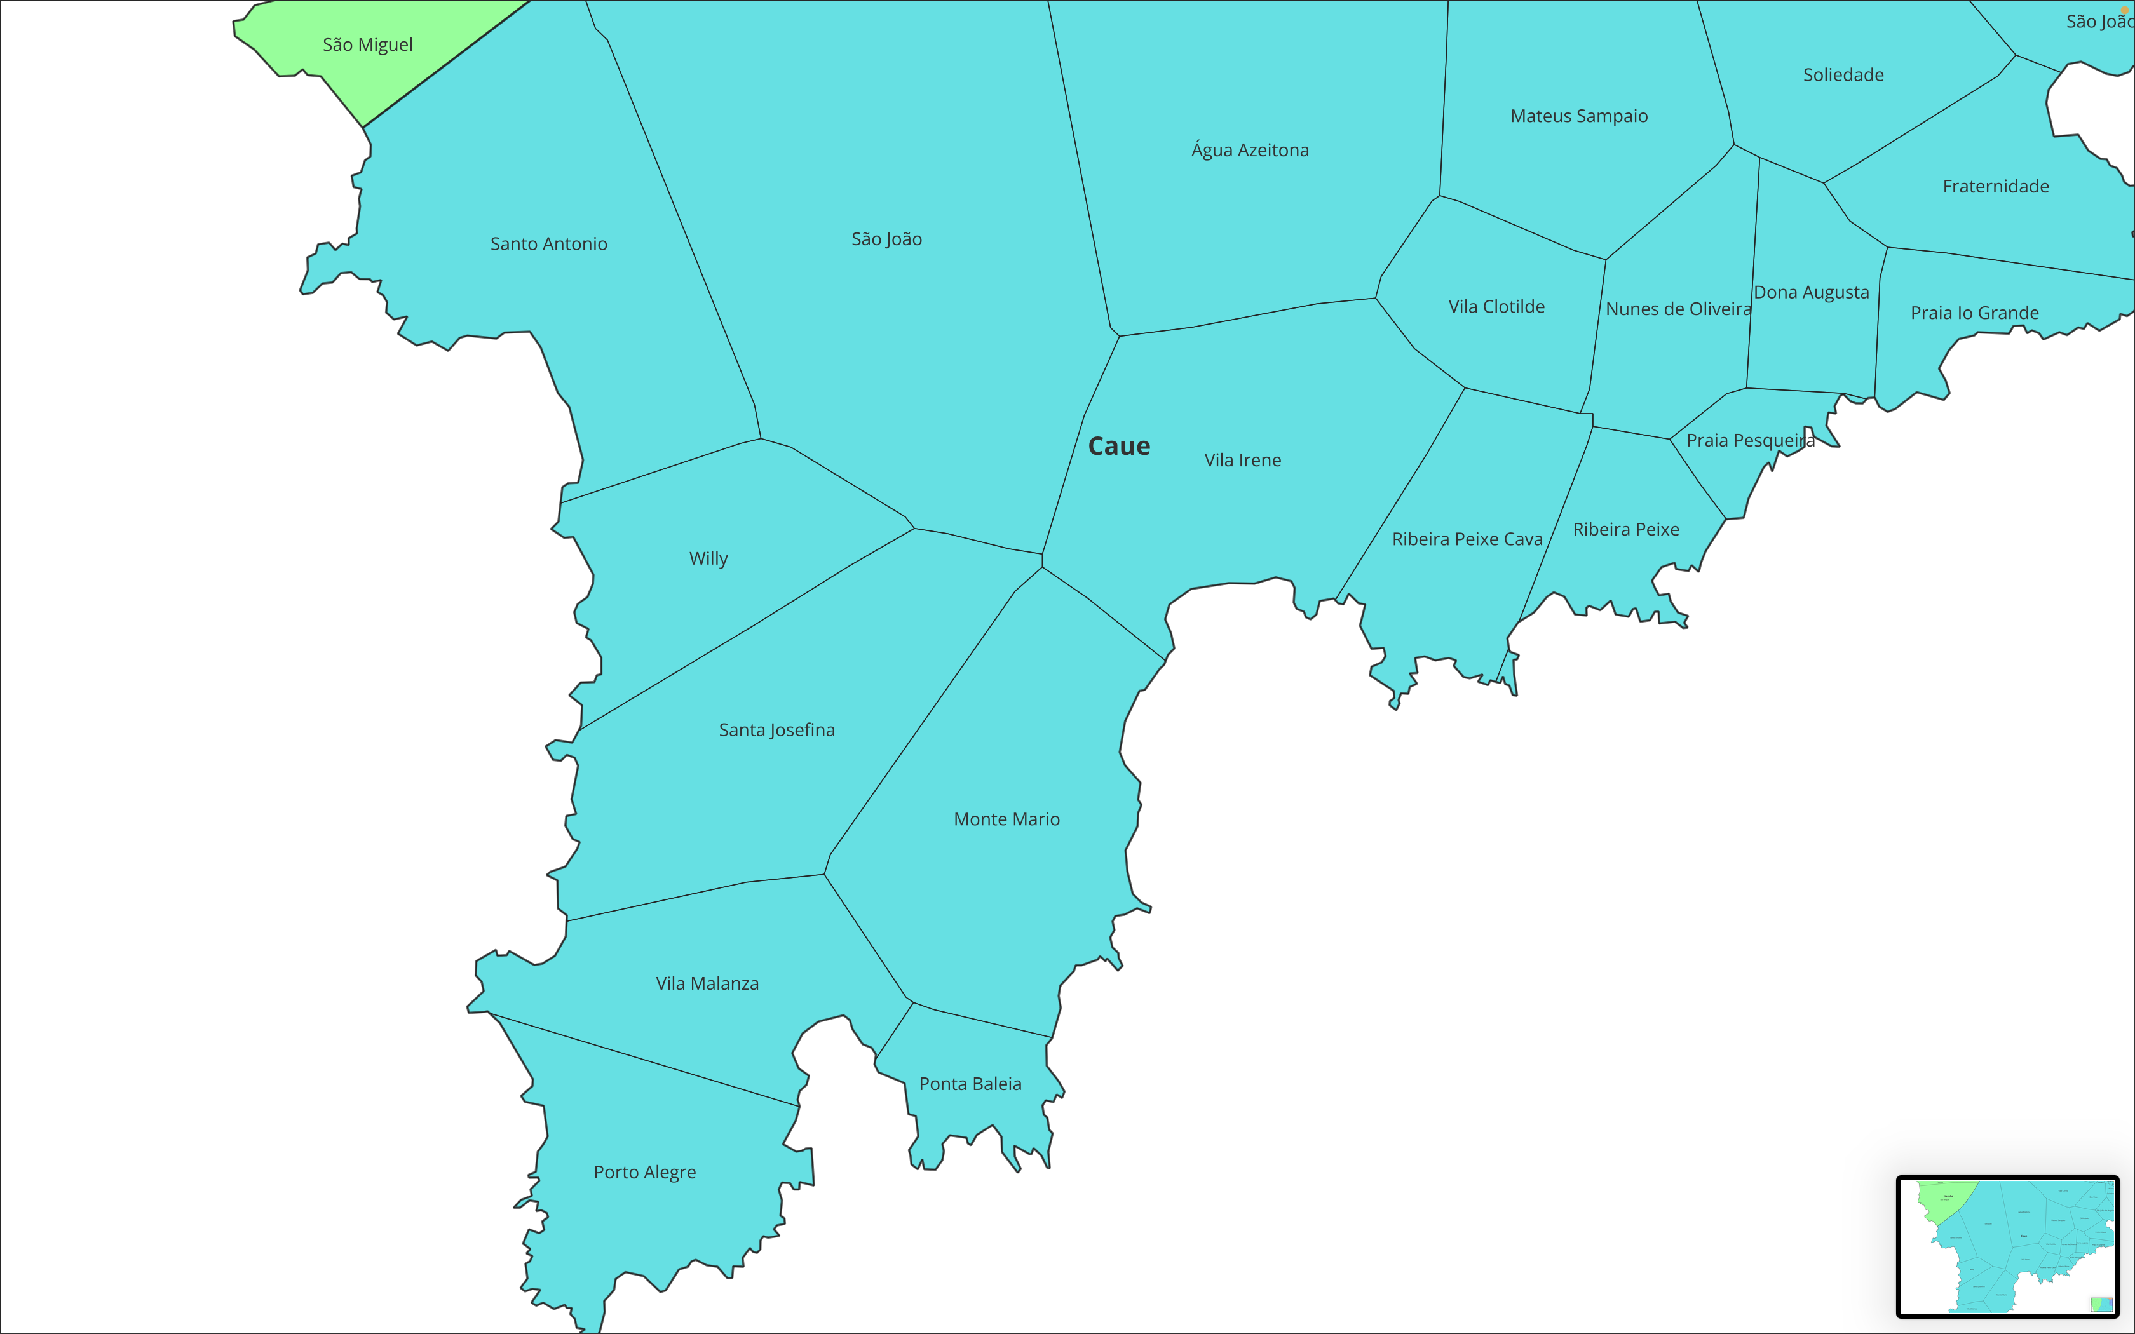

Slide 24
